Slide 1
SM9532 Lecture 4 Differences Across Countries: The CAGE distance framework

Slide 2
Session Outline
Revisiting some motivations
From Big C to the CAGE
CAGE – country level
CAGE industry level
The Honda Episode
Interfacing the vantage points

Slide 3
Basic Rationalisations ……….
Drying out of profitable
businesses
-competition/
mature markets
Establishing new
markets globally
4
3
National
Global
1
New opportunities
abroad
Entrenched
Profitability
2

Slide 4
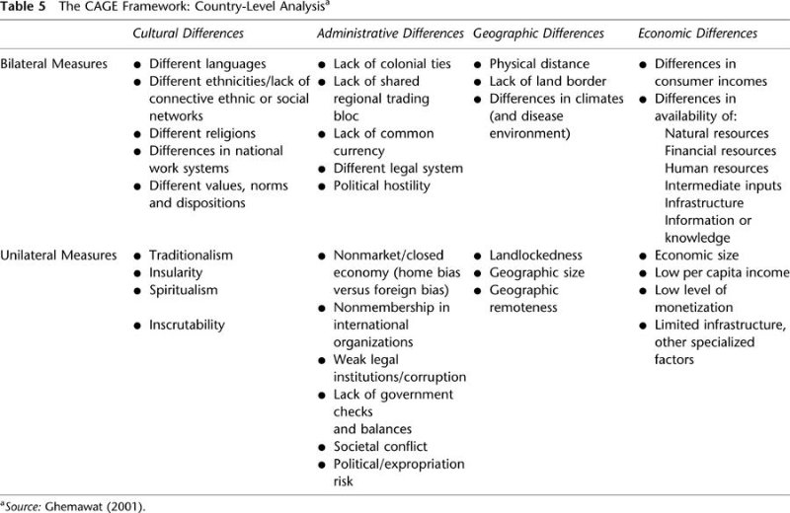
The BIG ‘C’ (culture) based models to the CAGE

Slide 5
IS DISTANCE A PROBLEM ?

Slide 6
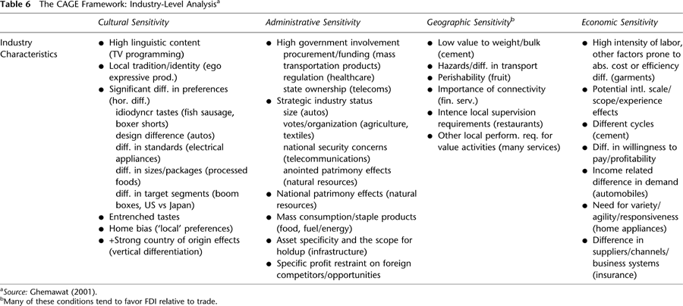

Slide 7

Honda motorcycles internationalisation
http://www.youtube.com/watch?v=ysmG_NfQVb0

Slide 8
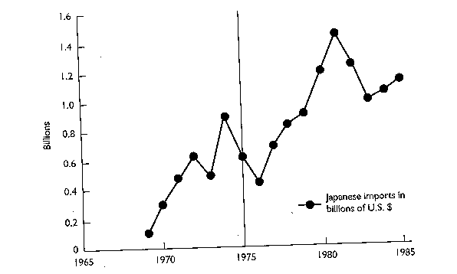
Sales of Japanese Motorcycles in the USA

Slide 9
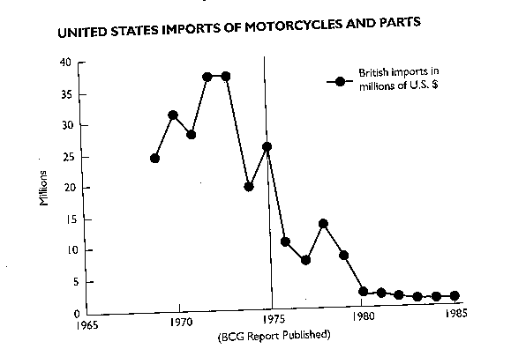
Sale of British Motorcycles in the USA

Slide 10

Honda Story Different views
View 1: Production efficiencies
The Japanese motorcycle industry, and in particular Honda, the market leader, present a [consistent] picture. The basic philosophy of the Japanese manufacturers is that high volumes per model provide the potential for high productivity as a result of using capital intensive and highly automated techniques. Their marketing strategies are, therefore, directed towards developing these high volumes, hence the careful attention that we have observed them giving to growth and market share.

Slide 11
View 2: Persistence
In truth, we had no strategy other than the idea of seeing if we could sell something in the United States." Honda had to obtain a currency allocation from the Japanese Ministry of Finance, part of a government famous for supporting the competitiveness of its industry abroad. "They were extraordinarily skeptical," said the managers; ….they finally….
"Mr. Honda was especially confident of the 250cc and 305cc ma­chines," the managers continued …..about their leader.

Slide 12
View 3: Culture of Learning
While we run around being "rational," they use their common sense. The Honda people avoided being too rational. Rather than believing they could work it all out in Tokyo, they came to America prepared to learn. Sure they used their experience and their cost position based on …production volumes ……but only after they learned what they had to do.

Slide 13
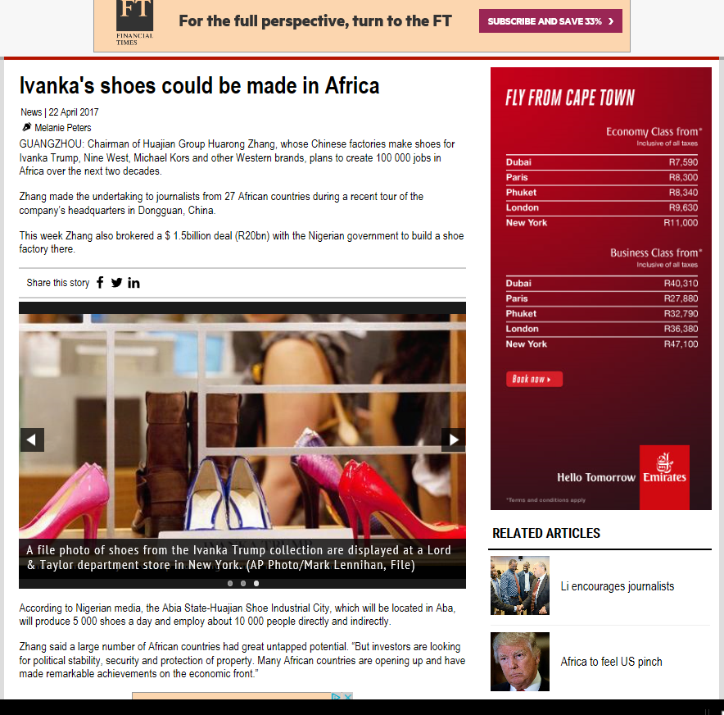
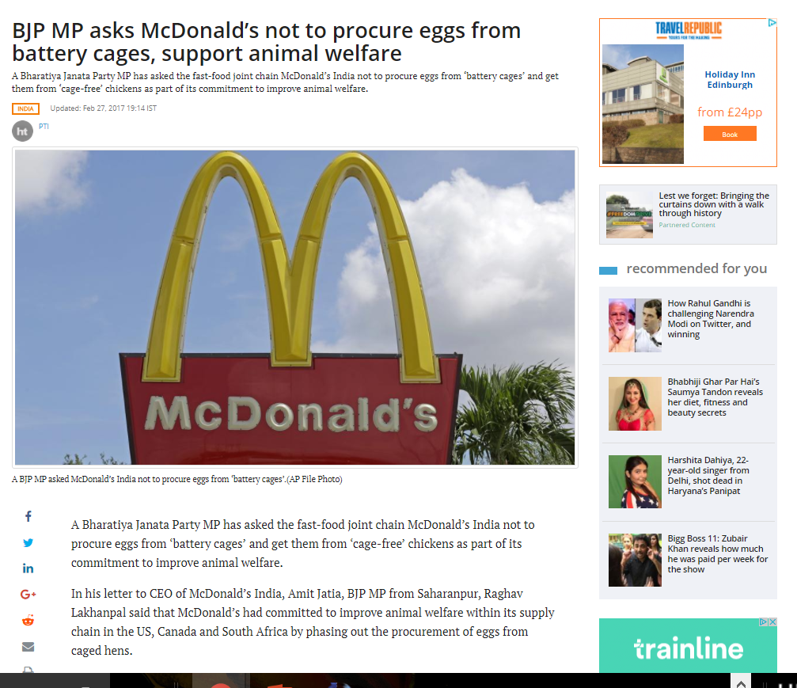
Interfacing the two vantage points: Industry and Country Level as UoA

