Slide 1
PSY1055 Advanced Psychology Research Skills
SEMESTER 2, WEEK 3
Practical
Multiple Linear Regression

Slide 2
LECTURE OUTLINE
Conducting a multiple regression in SPSS
Interpreting output from multiple regression
Assumptions first
Interpret output
Reporting multiple regression

Slide 3
LECTURE OUTLINE
Conducting a multiple regression in SPSS
Interpreting output from multiple regression
Assumptions first
Interpret output
Reporting multiple regression

Slide 4
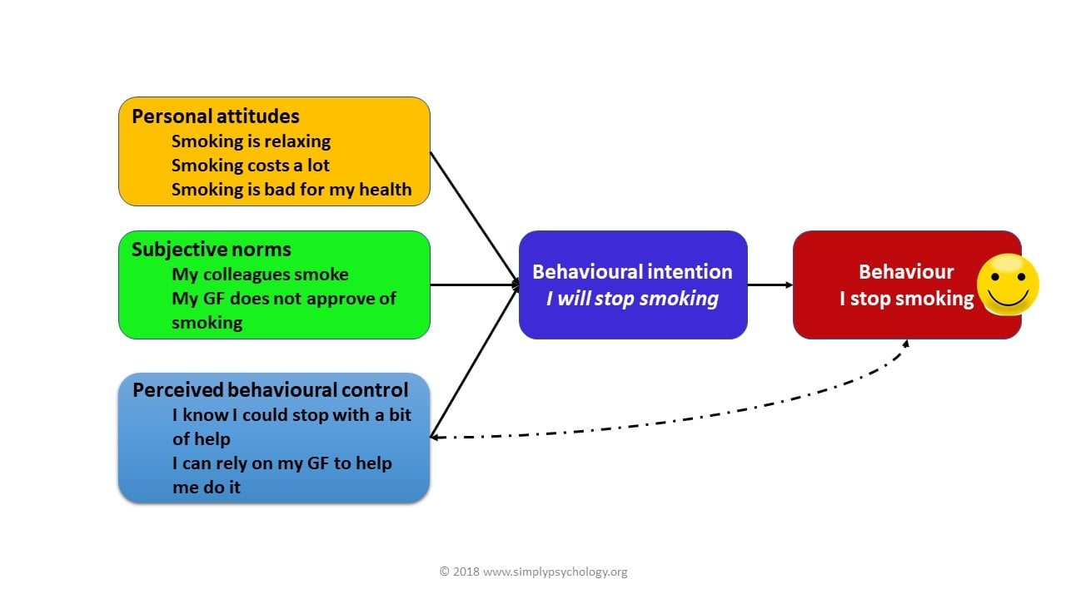
Practical Example: MR
Theory of Planned Behaviour (Ajzen, 1991)

Slide 5
Practical Example: MR
You are interested in using the Theory of Planned Behaviour to attempt to predict a group of students’ behavioural intentions to exercise.
The theory itself suggests that behavioural intentions tend to be hugely influenced by an
individual’s attitudes to the behaviour
their perceived behavioural norms concerning the behaviour (e.g. the influence of their peers)
perceived behavioural control of the behaviour (i.e. the degree to which they think they can successfully adopt the behaviour).
In order to test how well the theory predicts your students’ behavioural intentions to exercise, you have given them a questionnaire measuring attitudes to cycling, perceived behavioural norms, perceived behavioural control and behavioural intentions to cycle.

Slide 6
Practical worksheet
Name the predictor (IV variable) and levels
Name the criterion (DV variable)
Explain why multiple regression is appropriate for this analysis?

Slide 7

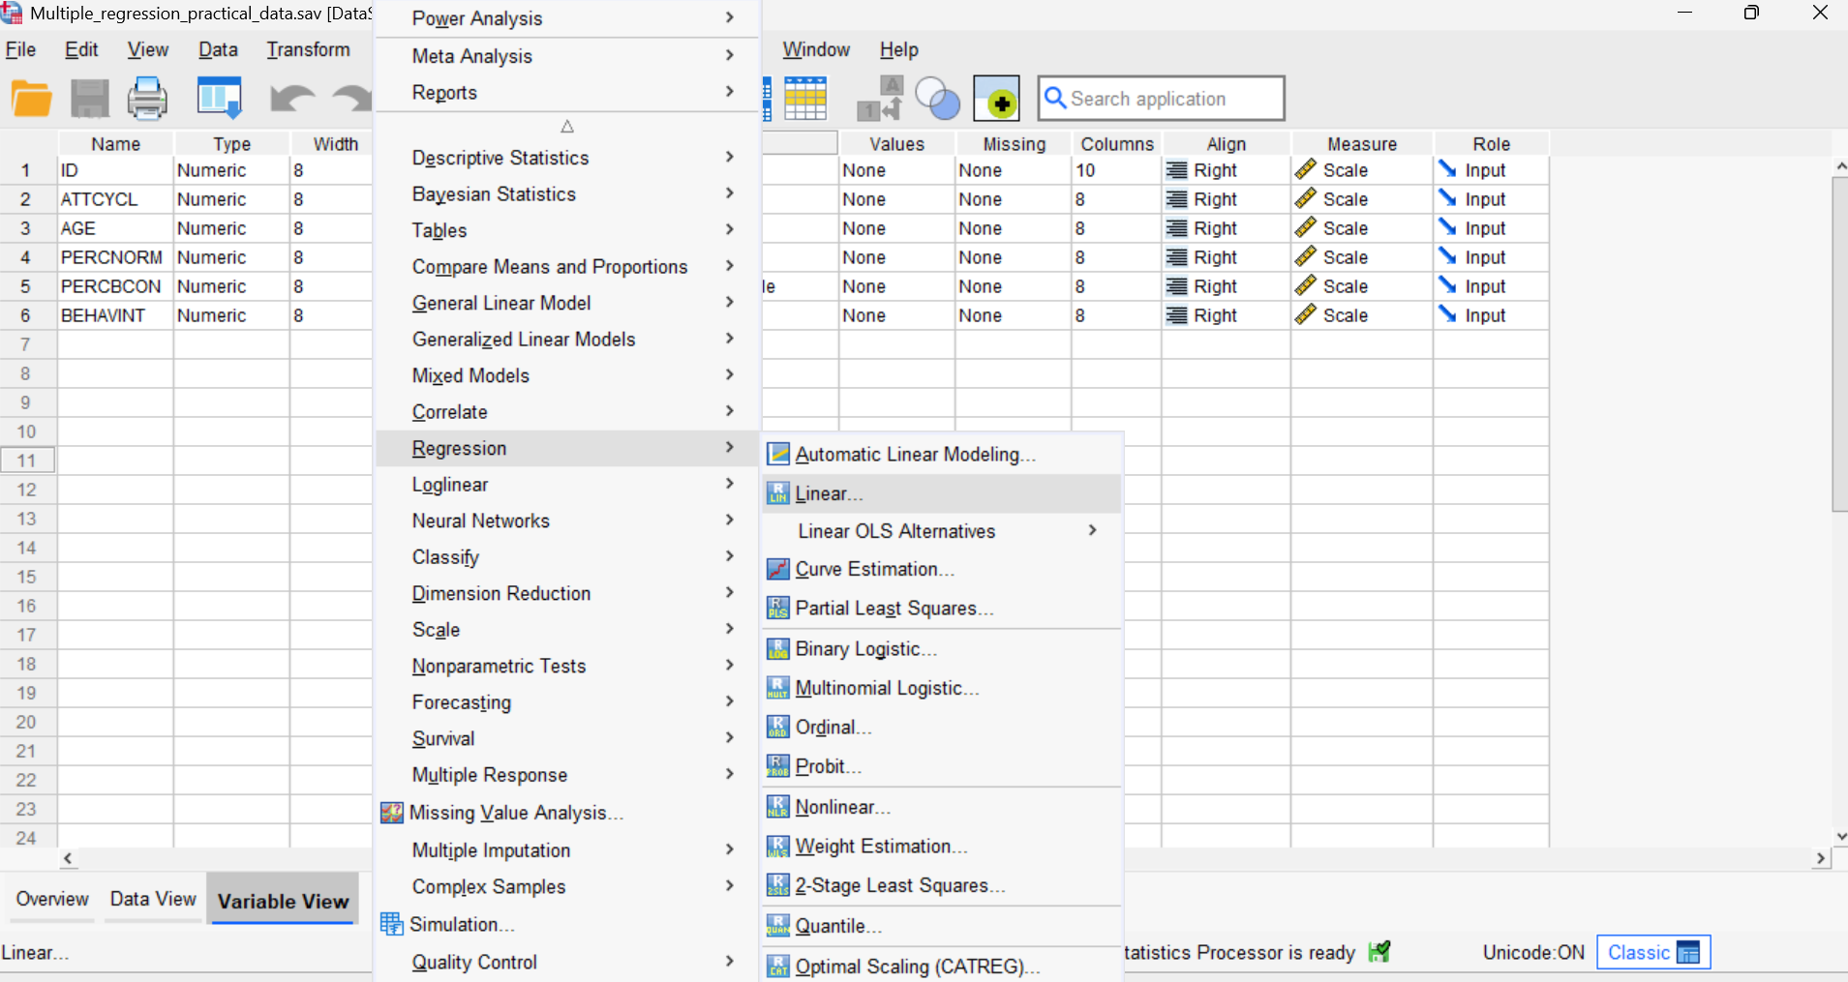
Procedure for running Standard Multiple Regression in SPSS (1)
Open Multiple Regression Practical Data.sav
Click Analyse → Regression → Linear.
Notes:
Collinearity diagnostics gives us tests that the predictors and outcome variables do not violate the assumption of absence of multicollinearity
Residuals information – this lets us be happy that there are no influential error cases that may be having too much of an effect on our slope
Durbin-Watson tests our assumption of independence of residuals

Slide 8
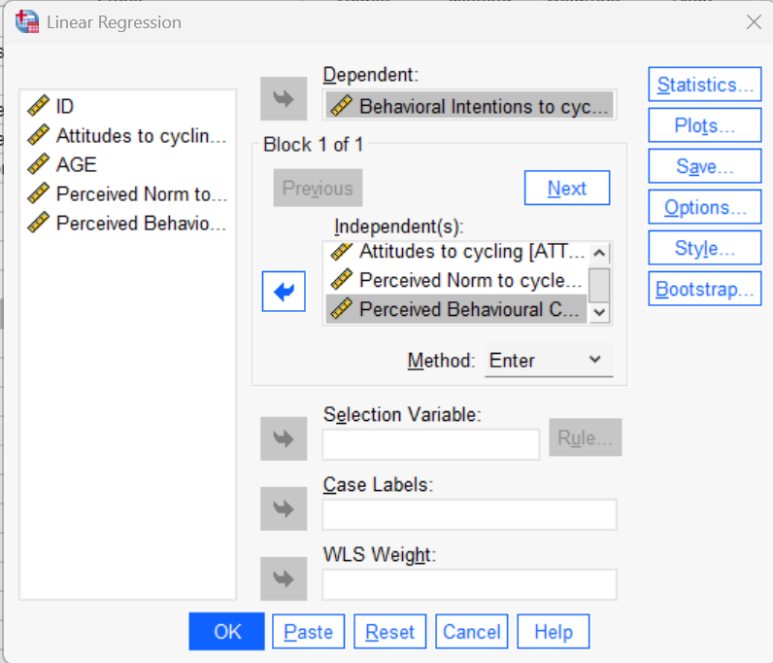
Procedure for running Standard Multiple Regression in SPSS (2)
In the main dialog box that opens…
Click on your continuous outcome variable & move to the Dependent box.
Click on your predictor variables and enter them into the Independent Box.
Ensure Enter is selected in Method Box
Notes:
Collinearity diagnostics gives us tests that the predictors and outcome variables do not violate the assumption of absence of multicollinearity
Residuals information – this lets us be happy that there are no influential error cases that may be having too much of an effect on our slope
Durbin-Watson tests our assumption of independence of residuals

Slide 9
Procedure for running Standard Multiple Regression in SPSS (3)
In the main dialog box that opens…
Click on your continuous outcome variable & move to the Dependent box.
Click on your predictor variables and enter them into the Independent Box.
Ensure Enter is selected in Method Box
Notes:
Collinearity diagnostics gives us tests that the predictors and outcome variables do not violate the assumption of absence of multicollinearity
Residuals information – this lets us be happy that there are no influential error cases that may be having too much of an effect on our slope
Durbin-Watson tests our assumption of independence of residuals

Slide 10
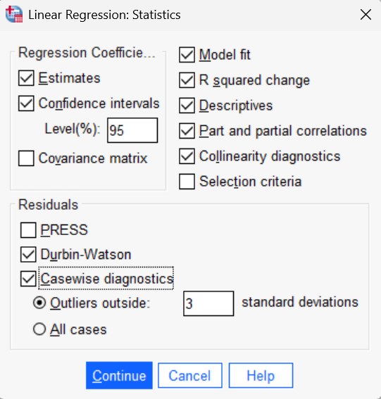
Procedure for running Standard Multiple Regression in SPSS (4)
Click Statistics
Select the following:
Estimates
Confidence Intervals
Model fit
R squared change
Descriptives,
Part and partial correlations
Collinearity diagnostics.
In Residuals section, select
Durbin-Watson
Casewise diagnostics
Outliers outside 3 SDs.
Click Continue.
Notes:
Collinearity diagnostics gives us tests that the predictors and outcome variables do not violate the assumption of absence of multicollinearity
Residuals information – this lets us be happy that there are no influential error cases that may be having too much of an effect on our slope
Durbin-Watson tests our assumption of independence of residuals

Slide 11
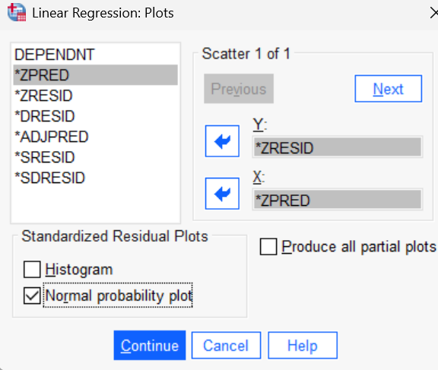
Procedure for running Standard Multiple Regression in SPSS 3 (5)
Click Plots Button.
Click on *ZRESID and move it into the Y Box.
Click on *ZPRED and move it into the X Box.
In the Standardized Residual Plots Section, tick Normal probability plots.
Click Continue.
Notes:
ZRESID = This converts residuals into z-scores
ZPRED = This converts individual predictor scores into z scores for our parameter tests
Normal probability plots – This creates tests of normality based on the Z-residual plot
Mahalanobis – This is our measure of multivariate outliers
Cook’s – This is our measure of how much unusual cases or outlying cases is having an undue influence on our model
Exclude Cases Pairwise – This is done to ensure that we do not ignore cases with missing values not on our variables of interest here (e.g. demographic variables like age that we are not including).

Slide 12
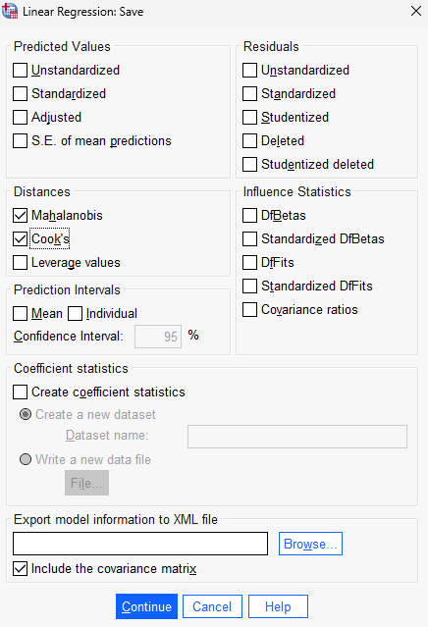
Procedure for running Standard Multiple Regression in SPSS (6)
Click Save Button.
In the Distances section select Mahalanobis and Cook’s.
Click Continue.
Notes:
Mahalanobis – This is our measure of multivariate outliers
Cook’s – This is our measure of how much unusual cases or outlying cases is having an undue influence on our model
Exclude Cases Pairwise – This is done to ensure that we do not ignore cases with missing values not on our variables of interest here (e.g. demographic variables like age that we are not including).

Slide 13
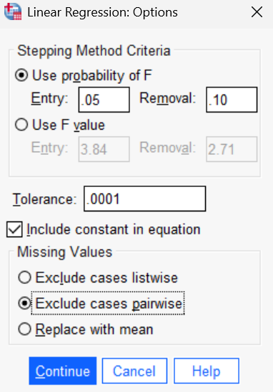
Procedure for running Standard Multiple Regression in SPSS (7)
Click Options Button.
Tick Exclude Cases Pairwise.
Click Continue and Ok.
Notes:
Mahalanobis – This is our measure of multivariate outliers
Cook’s – This is our measure of how much unusual cases or outlying cases is having an undue influence on our model
Exclude Cases Pairwise – This is done to ensure that we do not ignore cases with missing values not on our variables of interest here (e.g. demographic variables like age that we are not including).

Slide 14
LECTURE OUTLINE
Conducting a multiple regression in SPSS
Interpreting output from multiple regression
Interpret output
Assumptions
Reporting multiple regression

Slide 15
In a Standard Multiple Linear Regression you are trying to find out…
1. Is my regression model better than the mean for predicting outcomes?
2. How much of the variance in the Outcome is explained by the Predictor?
3. Is the Predictor (IV) significantly related to the Outcome (DV?)
4. What is the size and direction of the relationship between the Predictor and Outcome?

Slide 16
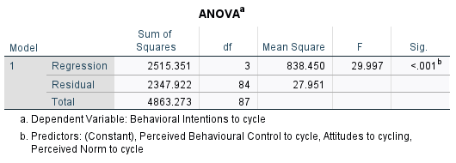
Multiple Regression Output (1)
1. Is my regression model better than the mean for predicting outcomes?
Examine ANOVA Table
This provides a test for the fit of the model.
A significant p value (p<.05) for the F test indicates the model is a significantly better fit of the outcome variable scores compared to the mean.
What does our ANOVA table tell us?

Slide 17
Multiple Regression Output (1 Contd)
1. Is my regression model better than the mean for predicting outcomes?
A significant p value for F statistic indicates our model is a significantly better fit of the outcome variable scores compared to the mean,
F(3, 84)=30.00, p<.001
.

Slide 18
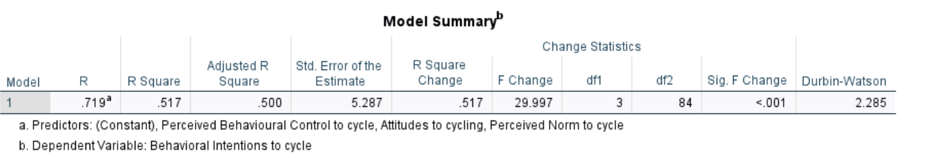
Multiple Regression Output (2)
2. How much of the variance in the Outcome is explained by the Predictors?
Examine Model Summary Box for
R² Statistic (Coefficient of determination) indicates the Percentage Variance Explained by the Model
R² of 0.517 = 51.7% variance in outcome (i.e., behavioural intentions to cycle) is explained by predictors (perceived behavioural control, attitudes and perceived norms)
Note we also report Adjusted R² a corrected version of R that penalises against addition of predictors (R² will always increase when you add predictors even if they don’t help improve the model).

Slide 19
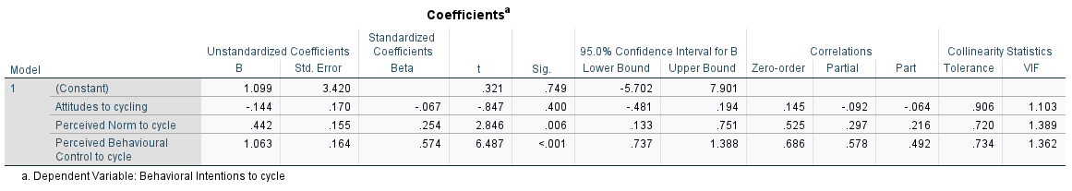
Multiple Regression Output (3)
3. Are the Predictors (IVs) significantly related to the Outcome (DV?)
The t-test for each parameter in the Coefficients table is a measure of it’s usefulness
b₀ – The height of the model or point of intersection with the y-axis as compared to 0
b₁ – The slope of the first parameter in our model as compared to 0
b₂ – The slope of the second parameter in our model as compared to 0

Slide 20
Multiple Regression Output (3)
3. Are the Predictors (IVs) significantly related to the Outcome (DV?)
Look at significance of t-test in coefficients table.
For attitudes towards cycling t=-847, p>.05, (our p value is .400, which is greater than p=.05)
Indicating that predictor 1 (i.e., attitudes towards cycling) IS NOT statistically significantly related to the outcome variable (behavioural intentions to cycle)

Slide 21
Multiple Regression Output (3)
3. Are the Predictors (IVs) significantly related to the Outcome (DV?)
Look at significance of t-test in coefficients table.
For attitudes towards cycling t=-847, p>.05, (our p value is .400, which is greater than p=.05)
Indicating that predictor 1 (i.e., attitudes towards cycling) IS NOT statistically significantly related to the outcome variable (behavioural intentions to cycle)
Attitudes to cycling did not significantly predict behavioural intentions above the mean, b=-.067, p=.40.

Slide 22
Multiple Regression Output (3)
3. Are the Predictors (IVs) significantly related to the Outcome (DV?)
Can you interpret whether the following predictors are significantly related to the outcome variable (i.e., behavioural intentions to cycle)
1.) Perceived norms to cycle
2.) Perceived behavioural control to cycle

Slide 23
Multiple Regression Output (3)
3. Are the Predictors (IVs) significantly related to the Outcome (DV?)
Attitudes to cycling did not significantly predict behavioural intentions above the mean, b=-.067, p=.40.
Perceived behavioural control explained more variance in behavioural intentions, than the mean b=.575, p<.001
Perceived norms explained more variance in behavioural intentions, than the mean b=.254, p=.006.

Slide 24
Multiple Regression Output (4)
4. What is the size and direction of the relationship between the Predictor and Outcome?
Check Coefficients Table
The Standardised Beta Coefficients (converted to a standardised score)
What it tells us: The relative strength and direction of each predictor’s effect on the outcome variable, expressed in standard deviation units.
Interpretation: A higher absolute value of β indicates a stronger predictor.
Key point: β shows the relative importance of predictors but includes shared variance with other predictors.
The bigger the standardised coefficient for a predictor, the greater percentage variance explained that the predictor contributes to the model.

Slide 25
Multiple Regression Output (4)
4. What is the size and direction of the relationship between the Predictor and Outcome?
Standardised Beta (β) here is .254, indicating that with 1SD increase in the predictor (perceived norms for cycling) there is a .254 SD increase in behavioural intentions to cycle
A larger (β) indicates a stronger relationship with the outcome
Sign -/+ indicates whether the relationship is positive or negative.
Standardised beta coefficient basically the slope but converted into a z score of types where we can compare different IVs measured on different scales

Slide 26
Evaluating the Regression Output (4)
4. What is the size and direction of the relationship between the Predictor and Outcome?
Looking at the coefficients table, which of the variables (IVs) predicted the greatest variance in behavioural intentions (DV)?
Perceived behavioural control was the strongest predictor (i.e., explained the most variance) in behavioural intentions b=.575, p<.001, followed by perceived norms b=.254, p=.006. However, attitudes to cycling did not significantly predict behavioural intentions, b=-.067, p=.40.

Slide 27
Evaluating the Regression Output (5)
4. What is the size and direction of the relationship between the Predictor and Outcome?
The Unstandardised Coefficients would be used as the values to enter in to your regression equation
e.g. ŷ_{i} = (b₀ + x_{i1}b₁ + x_{i2}b₂ + x_{i3}b₃ + x_{i4}b₄ …) + e_{i} becomes…
ŷ_{i} = {-8.98 + (0.217)x_{i1} + (-0.163)x_{i2} + (1.758)x_{i3}} + e_{i}
Note: the constant = b₀ (i.e. point of intersection with the y-axis)

Slide 28
Evaluating the Regression Output (7)
4. What is the size and direction of the relationship between the Predictor and Outcome?
Part Correlation Coefficient (also known as semipartial correlation coefficient)
What it tells us: The unique contribution of a predictor to the dependent variable, after removing overlap with other predictors.
Interpretation: Squaring the part correlation coefficient gives the proportion of variance in the outcome that is uniquely explained by that predictor.
Key point: Part correlation shows the unique contribution of a predictor, while β shows the total effect (including shared variance).

Slide 29
Reporting the Multiple Regression
.
1. Introduce the analysis
What was the purpose of Multiple regression?
What hypothesis you were testing?
What were the various levels of the IV?
What was the DV?
List whether the assumptions of multiple regression were violated or not (e.g., linearity, multicollinearity etc).
2. Overall model fit
Report if the model is statistically significant
F (df1, df2) = XXX, p >/<.05
Report how much of the variance was explained by the model
(R², and adjusted R², to indicate proportion of variance explained by the model)
3. Regression coefficients
Report on regression coefficients, commenting on whether the Ivs predicted the DVs.
B= [unstandardized coefficient], SE= [standard error], β=beta [standardized coefficient], t=[t-value], p= [p-value]).

Slide 30
Writing up Multiple Regression Results in APA format
A multiple regression analysis was conducted to examine the relationship between [criterion variable] and [predictor variables]. The overall model was significant, F(df1,df2)= [F-value], p= [p-value], explaining [R²]% of the variance in [criterion variable] (R² = [R-squared], Adj. R² = [Adjusted R-squared]).
[Predictor 1] was a (non)/significant predictor of [Criterion variable] (unstandardized coefficients (B)= [B value], standard errors (SE) = [ SE], standardized coefficients (β)= [β Value], t statistic = [ T value ], and p-values [ ] for each predictor.[Independent variable 2] was [not] significant (B= [ ], SE= [ ], β = [ ], t = [ ], p= [ ].)
The results indicate that [briefly interpret findings, e.g., "higher levels of X were associated with higher/lower levels of Y, while controlling for other predictors"]. However, [discuss non-significant predictors or unexpected findings]. These findings suggest that [implications of results].

Slide 31
Practical
Have a go at writing up the results of this analysis in APA format

Slide 32
Writing up Multiple Regression Results in APA format
A multiple regression analysis was conducted to examine the relationship between behavioural intention to cycle and attitudes towards cycling, cycling norms and perceived control over cycling behaviour. The overall model was significant, F(3, 84)=30.00, p<.001, explaining 51.7% of the variance in behavioural intentions to cycle (R² = .517, Adj. R² = .500).
Perceived behavioural control predicted behavioural intentions to cycle, (B=1.06, SE=.164, b=.574, t=6.487 p=.006). Perceived norms to cycle also predicted behavioural intentions to cycle, (B=.442, SD=.155, b=.254, t-2.846, p<.001). However, attitudes to cycling did not significantly predict behavioural intentions (B=-144, SE=.170, b=-.067, t=-.847, p>.05)
The results indicate that higher levels of perceived behavioural control and perceived norms to cycle were associated with higher levels of behavioural intentions to cycle, while controlling for other predictors. However, contrary to expectations attitudes to cycling were not related to behavioural intentions.

Slide 33
Assumptions of Multiple Regression
2. Normality of residuals
3. Independence of observations (or independence of errors)
4. Homoscedasticity
6. No outliers, influential points
5. Linear relationship between each IV and DV
1. Little/No Multicollinearity
Assumption
Check
Assumption met if
Cooks distance, leverage & visual inspection of scatterplot
Normal Probability Plot (P-P) of Regression Standardised Residual
Scatterplots (regression output)
Scatterplots (regression output)
Correlations/
Tolerance/VIF
Durbin Watson statistic
Cook’s distance
Cooks value should be less than 1 (otherwise indicates influential point). No values distorting line disproportionately
VIF less than 10
Tolerance greater than .10
Correlation less than .7
Bell curve to histogram or pp plot approximately follows the line
Should be equal to 2
Should look like a cloud rather than a funnel
Evenly scattered – not curved

Slide 34
Assumptions of Multiple Regression
Dependent variable is continuous (interval or ratio)
Independent variables are continuous (interval or ratio) or categorical (nominal or ordinal)
Independence of observations - assessed using Durbin-Waston statistic
Linear relationship between the dependent variable and each independent variable - visual exam of scatterplots
Homoscedasticity - assessed through a visual examination of a scatterplot of the residuals
No multicollinearity (high correlation between independent variables) - inspection of correlation values and tolerance values
No outliers or highly influential points - outliers can be detected using casewise diagnostics and studentized deleted residuals
Residuals are approximately normally distributed - checked using histogram, P-P Plot, or Q-Q Plot of residuals.

Slide 35
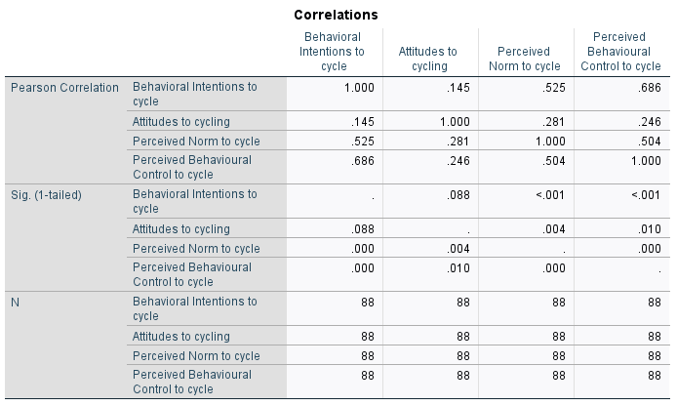
Checking for Assumptions: 1. Multicollinearity
Checking multicollinearity
Correlations table
If r>0.7 assumption violated
Correlations table demonstrates degree of correlation between all variables.
We expect some degree of correlation between predictors and outcome for them to be useful.
But High correlations between predictors (e.g. >0.7) may indicate multicollinearity/singularity.
Looking at our correlations table, does multicollinearity look like an issue?
No. Although correlation between intentions and control is high r=.686, it falls just within the threshold.
Notes:
High correlations (e.g. >0.7) may indicate multicollinearity/singularity (this may be true of certain predictors – e.g. self-efficacy and perceived behavioural control towards a task are constructs that are quite theoretically similar so we might find high correlations between these variables, suggesting that it might be more beneficial to drop one.

Slide 36
Checking for Assumptions: 1. Multicollinearity (Contd)
Checking multicollinearity
Coefficients table
If Tolerance <.1 or VIF >10 assumption violated
Coefficients Table (collinearity statistics) in Multiple Regression Output tests for Multicollinearity (which may not be picked up by eyeballing correlations).
Tolerance: How much variation explained by predictor variable alone (expect this to be greater than >0.1)
Variance Inflation Factor (VIF): How much variation explained by other predictors (expect this to be lower than 10)

Slide 37
Checking for Assumptions: 1. Multicollinearity (Contd)
Checking multicollinearity
Coefficients table
If Tolerance >.1 or VIF >10 assumption violated
Is our assumption of multicollinearity satisfied?
i.e.,
Is Tolerance greater than .1, (>0.1)
Is the Variance Inflation Factor (VIF) lower than 10?
Assumption of multicollinearity is met
Yes
Yes

Slide 38
Testing Assumptions of Multiple Regression 1. Multicollinearity
Solutions for multicollinearity
If 2 variables are highly correlated then you could remove an IV based on
Theoretical grounds
Low reliability of the variable
Alternatively, you could combine the two correlated ones
(e.g., instead of having a Depression and a Hopelessness scale, you could combine the 2 to make an overall Misery variable)
Notes:
Covariability of X and Y / separately
High Correlations are more of a problem in Regression than they are in MANOVAs
two or more independent variables that are highly correlated with each other. This leads to problems with understanding which independent variable contributes to the variance explained in the dependent variable, as well as technical issues in calculating a multiple regression model.

Slide 39
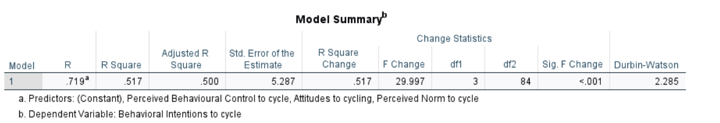
Checking for Assumptions: 2. Independence of residuals
Checking independence of residuals
Model summary table
Is the Durbin Watson value 0-1 or 3-4? If so assumption is violated
Residual terms should be uncorrelated
Tested with Durbin Watson statistic in Model Summary Table
The value of this statistic ranges from 0-4.
A value of 2 = no correlations at all between residuals
If value is between 0-1 or 3-4, residuals are too correlated: i.e. we want a value of between 1-3.

Slide 40
Checking for Assumptions: 2. Independence of residuals
Checking independence of residuals
Model summary table
Is the Durbin Watson value 0-1 or 3-4? If so assumption is violated
Is the assumption of independence of residuals met?
i.e., Is the Durbin-Watson value between 1-3 (indicating our assumption is met?)
Yes, Durbin-Watson value is 2.285, which falls within the accepted threshold

Slide 41
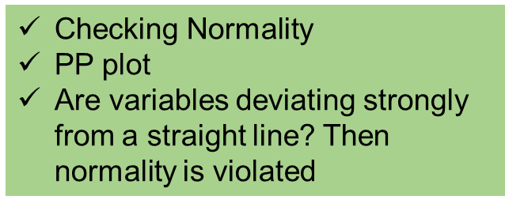
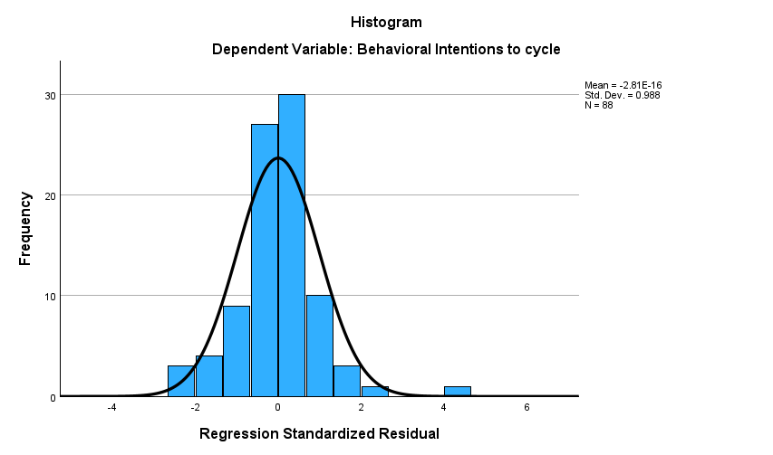
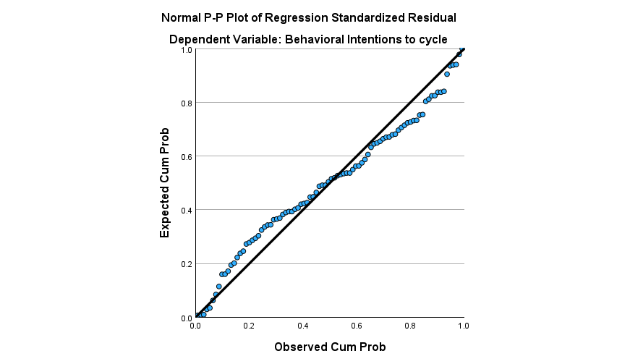
Checking Assumptions 3: 3. Normality of Residuals
Normal Probability Plot (P-P) of Regression Standardised Residual gives information about normality of residuals. We want variables to be present in a reasonably straight line
Histogram – bell curve shape

Slide 42
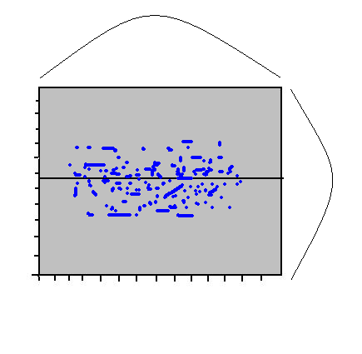
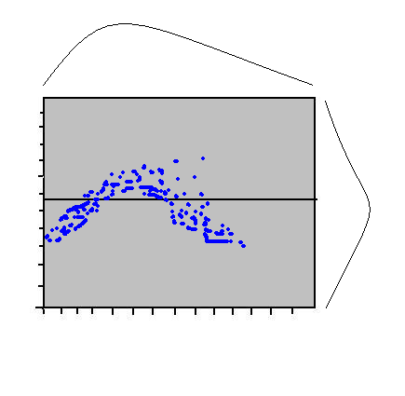
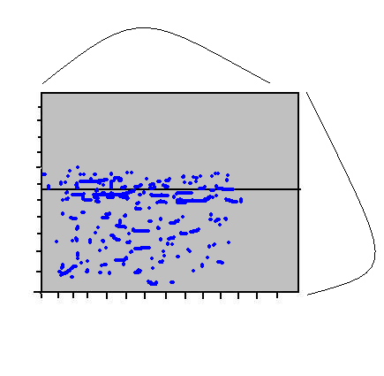
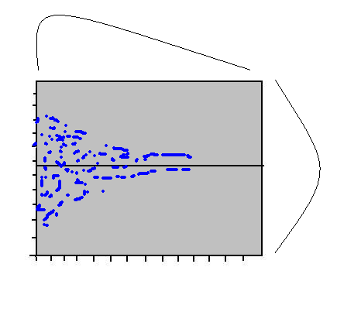
Checking for Assumptions 4: 4. Linearity between IV and DV after controlling for other predictors
Scatterplot also indicates linearity, normality & heteroscedasticity.
Should have reasonable scatter/spread throughout: a central rectangular shape indicates normality
A curvilinear shape indicates non-linearity.
A rectangle that is considerably off-centre indicates a skew.
More weight on one side suggests some degree of heteroscedasticity.
Notes:
Scatterplot relates to residuals – we want this to be heteroscedastic
As we saw last week, we can also observe other problems with our data from the scatterplot – what was this last week? Outliers

Slide 43
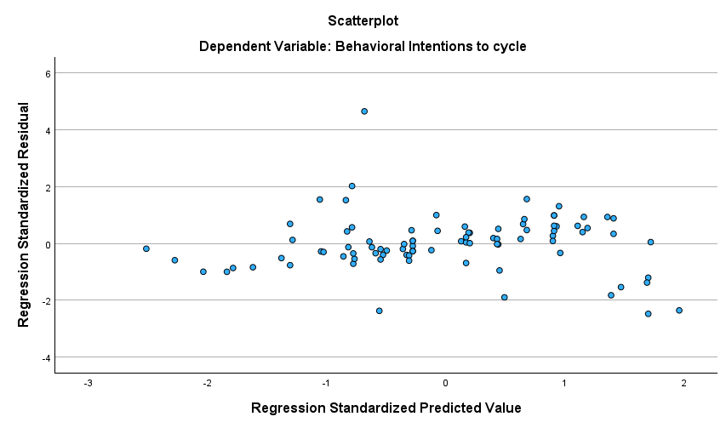
Checking for Assumptions 4. Linearity
Checking linearity
Scatterplot (part of regression output)
A curvilinear shape indicates non-linearity
Shape of the cloud
If strongly curved indicates violation of assumption
Are assumptions of linearity met?
i.e., are variables reasonably randomly scattered around zero, not clearly curved.
Yes, looks reasonably scattered.

Slide 44
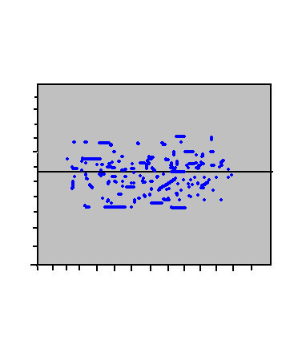
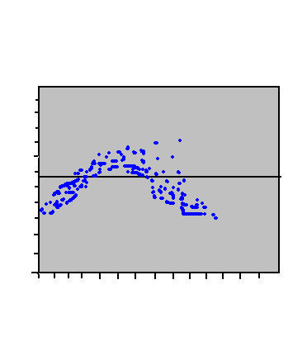
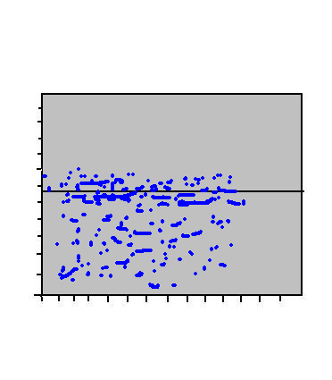
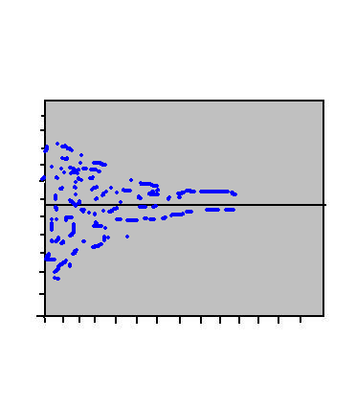
Checking for Assumptions 5. Homoscedasticity
Scatterplot indicates linearity, normality & heteroscedasticity.
Should have reasonable scatter/spread throughout: a central rectangular shape indicates normality
A curvilinear shape indicates non-linearity.
A rectangle that is considerably off-centre indicates a skew.
More weight on one side suggests some degree of heteroscedasticity.
Normality
Curvilinear
Skewed
Heteroscedasticity

Slide 45
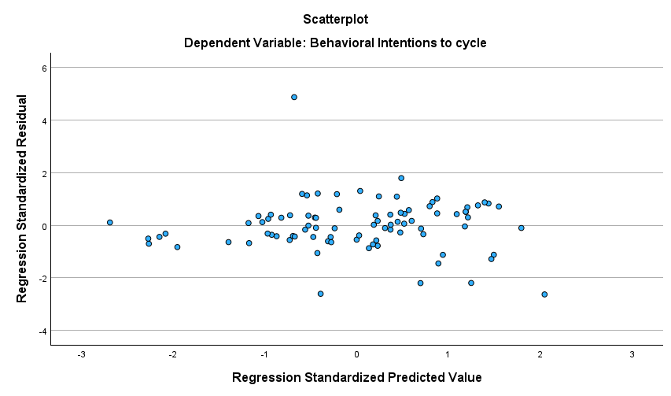
Checking for Assumptions 5. Homoscedasticity
Checking homoscedasticity
Scatterplot (part of regression output)
Are variables deviating from an approx. even spread above and below 0 [rectangle]? Then homoscedasticity is violated
Are assumptions of homoscedasticity met?
i.e., are variables presented in reasonably evenly above and below (0)?
Yes, the data are approx. evenly distributed above/blow 0

Slide 46
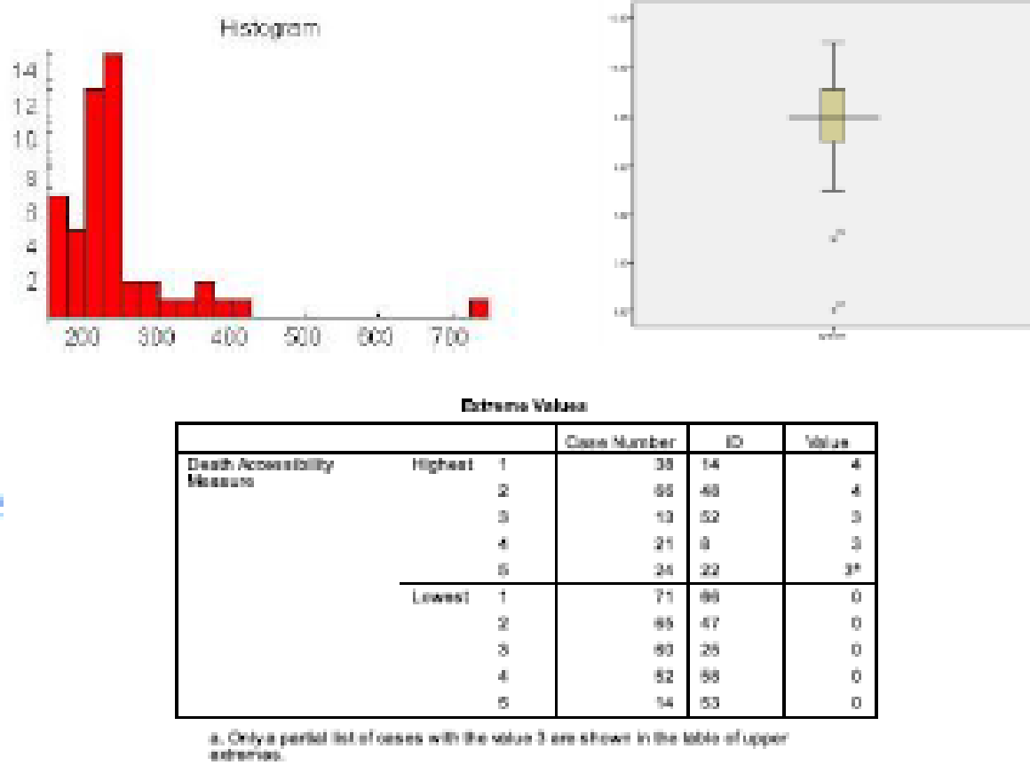
Checking for Assumptions 6. Outliers & Influential values
Univariate Outliers
Check Histogram
Check boxplot
Are there worrying outliers?
Check extreme values table
Are there values ≥ 3 SDs from mean?
Outliers ≥ 3 SDs: consider data transformation or substituting with less deviant scores
e.g. one outlier of 3.3 SDs from mean: reduce to score of one unit larger (or smaller) than next most extreme score.

Slide 47
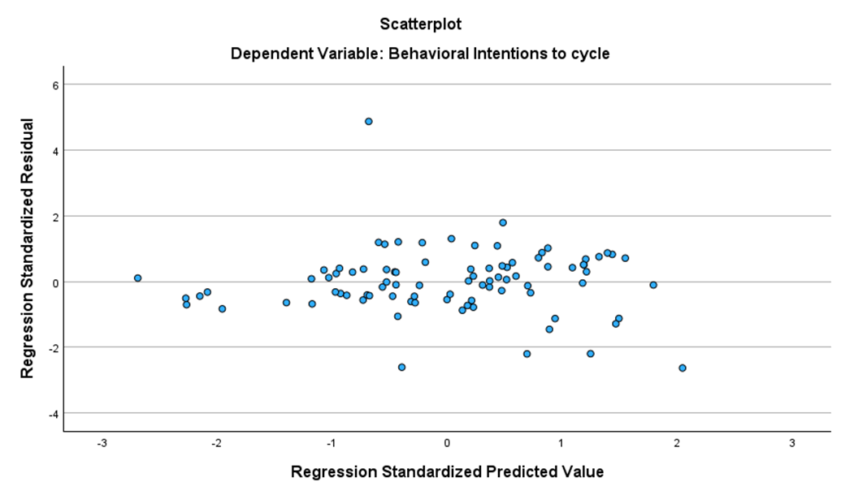
Checking for Assumptions 6. Outliers & Influential values
Scatterplot will give some indication of whether or not there are outliers that may be influencing model shape.

Slide 48
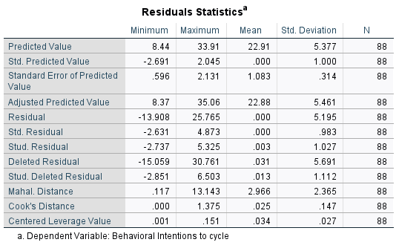
Checking for Assumptions 6. Outliers & Influential values
Multivariate Outliers are checked by examining Mahalanobis Distance value in Residual Statistics Table.
Check the Maximum value against a critical value for Mahalanobis Distance table (varies by number of independent variables).
Mahalanobis Distance values above the critical values, indicate the presence of multivariate outliers.
Number of predictor variables | Critical value | Number of Predictor variables | Critical value
2 | 13.82 | 5 | 20.52
3 | 16.27 | 6 | 22.46
4 | 18.47 | 7 | 24.32
Critical values for evaluating Mahalanobis distances

Slide 49
Checking for Assumptions 6. Outliers & Influential values
Checking multivariate outliers
Residual statistics
Does the Malanahobis distance value exceed the critical value?
If yes, the assumption is violated, there are multivariate outliers.
Are there multivariate outliers or not?
i.e.,) Is Mahalanobis Distance values above the critical values, indicate the presence of multivariate outliers.
We have 3 Ivs, so the critical value is 16.27. Does 13.14 exceed 16.27?
No – indicating we do not have any multivariate outliers
Number of predictor variables | Critical value | Number of Predictor variables | Critical value
2 | 13.82 | 5 | 20.52
3 | 16.27 | 6 | 22.46
4 | 18.47 | 7 | 24.32
Critical values for evaluating Mahalanobis distances

Slide 50
Checking for Assumptions 6. Outliers & Influential values
Checking multivariate outliers
Residual statistics
Does the Malanahobis distance value exceed the critical value?
If yes, the assumption is violated, there are multivariate outliers.
Are there multivariate outliers or not?
i.e.,) Is Mahalanobis Distance values above the critical values, indicate the presence of multivariate outliers.
We have 3 Ivs, so the critical value is 16.27. Does 13.14 exceed 16.27?
No – indicating we do not have any multivariate outliers
Number of predictor variables | Critical value | Number of Predictor variables | Critical value
2 | 13.82 | 5 | 20.52
3 | 16.27 | 6 | 22.46
4 | 18.47 | 7 | 24.32
Critical values for evaluating Mahalanobis distances

Slide 51

Interpreting Output Checking for Assumptions 6. Outliers & Influential values
Checking influential cases
Residual statistics
Does the Cook’s distance value exceed 1 (>1)
If yes, the assumption is violated, there are influential cases.
Influential cases
Cook’s Distance gives information on how much influential cases have affected our model.
Tabachnick & Fidell (2011) suggest values >1 on this statistic indicate a problem.

Slide 52
Interpreting Output Checking for Assumptions 6. Outliers & 7. Influential values
Checking influential cases
Residual statistics
Does the Cook’s distance value exceed 1 (>1)
If yes, the assumption is violated, there are influential cases.
Is our assumption of influential cases violated?
I.e., is Cook’s distance >1,
Yes, Cooks distance is >1, indicating that there may be some influential cases – our assumption has been violated

Slide 53
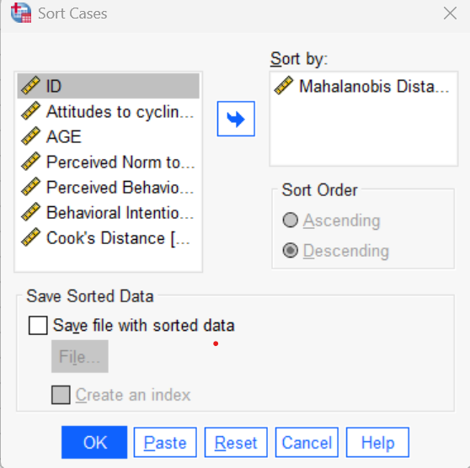
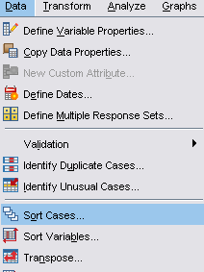
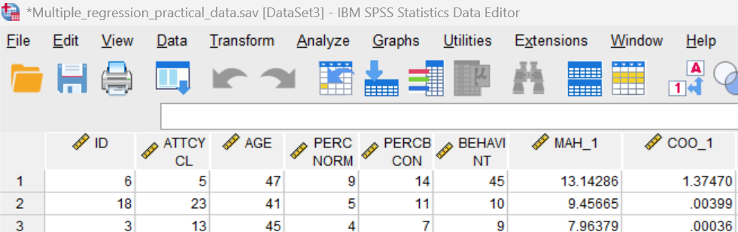
If you have a multivariate outlier or influential case… 1
Go to Data→ Sort Cases
Enter MAH_1 in Descending order
This will place the case with the multivariate outlier at the top of the file
Identify the outlying case (e.g. from your ID variable).
If the values exceed the cut off we could exclude (in this example, we do not need to exclude any cases)
Notes:
You can do this for influential cases too to check if a particular case is having too much of an influence on your data

Slide 54
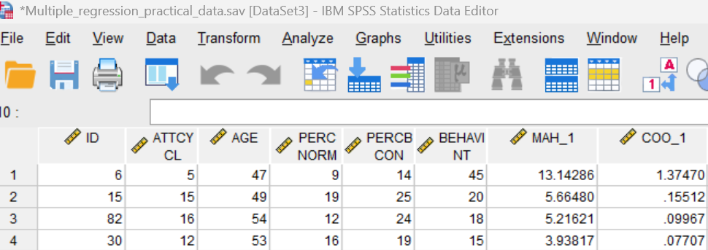
If you have a multivariate outlier or influential case… (2)
Also use this method with COO_1 to check for individual influential cases
Go to Data→ Sort Cases
Enter C00_1 in Descending order
This will place the case with the influential value at the top of the file
Identify the outlying case (e.g. from your ID variable).
We did have one value that exceeded the Cooks distance of <1.
So we could remove participant one, to meet our assumptions and remove all influential cases
Notes:
You can do this for influential cases too to check if a particular case is having too much of an influence on your data

Slide 55
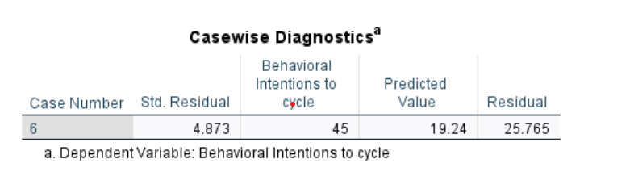
If you have a multivariate outlier or influential case… 2
Check Casewise Diagnostics Table
This indicates if your standardised residual for the multivariate outlier (i.e. Z-score) is >3 SDs from the normal distribution.
This table will not appear if there is no multivariate outlier >3 SDs.
If predicted value is very different to value, you might consider removing the case.

Slide 56
Reporting Assumptions APA (Template)
Prior to conducting the multiple regression, assumptions were examined. Inspection of scatterplots and partial regression plots indicated linear relationships between predictors and the outcome variable. Residuals were independent, as indicated by a Durbin–Watson statistic close to 2. Visual inspection of plots of standardised residuals against standardised predicted values suggested homoscedasticity. Normality of residuals was supported by inspection of histograms and normal P–P plots. Multicollinearity was not evident, with variance inflation factor (VIF) values below 5. No influential cases were identified based on Cook’s distance values below 1.

Slide 57
Practical worksheet
Open the Wk 8 Multiple regression practical Data file and run the Procedure for Standard Multiple Regression
After testing assumptions and excluding outliers/extreme cases, re-run analyses and…
Answer Questions (a) to (f) on the worksheet

Slide 58
Recommended Reading
Julie Pallant (SPSS Survival Manual) Chapter 13
Tabachnick & Fidell Chapter 5
Andy Field Book Chapter 7

Slide 59
Summary Week 8
LECTURE: Introduction to multiple regression
PRACTICAL: Conducting multiple regression & assumptions
TASK: Upload worksheet practical
ASL:
Multiple regression.

Slide 60
Thanks

