Slide 1
PSY1055 Advanced Psychology Research Skills
SEMESTER 2, WEEK 3
LECTURE
Multiple Linear Regression

Slide 2
LECTURE OUTLINE
Recap: Linear Regression
What is Multiple Regression (MR)?
Standard Multiple Regression
Assumptions
Sample size & Effect Size
Types

Slide 3
LECTURE OUTLINE
Recap: Linear Regression
What is Multiple Regression (MR)?
Standard Multiple Regression
Assumptions
Sample size & Effect Size
Types

Slide 4
Recap: Simple Linear Regression
In regression, one variable is the criterion variable [outcome] (Y) and the other is a predictor variable (X).
In experimental research, these are usually referred to as the dependent variable (DV) and independent variable (IV),
The regression model creates a line that predicts values of Y from X.
If there is one predictor, this is called simple linear regression (e.g., does ‘study hours’ predict ‘exam scores’

Slide 5
Simple Linear Equation
Equation for a linear regression :
Y = b₀ + b₁X + e
Where:
b₀ = the intercept (or constant – point at which the line crosses the vertical axis)
b₁ = the slope (gradient of the line)
X = the (observed) score
Y = the (predicted) score
e = residual (difference between what was predicted by the line and the actual score)
Notes:
Equation is often conceptualised without the residual term but it just represents the fact that the model will not fit the data collected perfectly.

Slide 6
Regression Parameters
1. Point of intersection with y axis = β0
Beta 0 value (intercept) = constant (it does not change)
Represents the expected value of the dependent variable when all predictors are zero
2. Slope = β1.
Beta 1 values (slope/gradient) = Represents the expected change in the dependent variable for a one-unit increase in the predictor, holding other predictors constant
1 unit increase in outcome is associated with an associated Beta 1 value change in predictor
E.g. Beta 1 value = -2.71 means that a one unit increase in the outcome variable is associated with a -2.71 decrease in the value of the predictor variable.
3. Error (Residuals) ε
Variability in the dependent variable not explained by the predictors

Slide 7
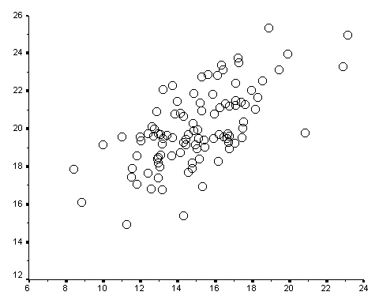
Parameters of a Linear Regression
Y = b₀ + b₁X + e
Line of best fit – line that best fits the data
Intercept is where the line cuts ‘Y’ when ‘X’ is ZERO
Income (Y)
Slope refers to the incline / decline of the line i.e. its steepness
Education (X)

Slide 8
Parameters of a Linear Regression
Education = [intercept]₀ + [slope]₁(Income) + error
Intercept is where the line cuts ‘Y’ when ‘X’ is ZERO
Income (Y)
Slope refers to the incline / decline of the line i.e. its steepness
Education (X)

Slide 9
‘Error’ or ‘Residuals’ in Regression
Y
.
y_{i}
{
X
x_{i}

Slide 10
In a Simple Linear Regression you are trying to find out…
1. Is my regression model better than the mean for predicting outcomes?
2. How much of the variance in the Outcome is explained by the Predictor?
3. Is the Predictor (IV) significantly related to the Outcome (DV?)
4. What is the size and direction of the relationship between the Predictor and Outcome?

Slide 11
1. Is my regression model better than the mean for predicting outcomes?
2. How much of the variance in the Outcome is explained by the Predictor?
3. Is the Predictor (IV) significantly related to the Outcome (DV?)
4. What is the size and direction of the relationship between the Predictor and Outcome?
F test in ANOVA
R² (coefficient of determination) is .562, indicating that 56.2% of variance in outcome (i.e., exam score) is explained by the predictor (i.e., tutorial attendance).
Look at significance of t-test in coefficients table. indicating that the predictor variable is significantly related to the outcome variable
Slope (B) indicates that for every 1-unit increase in the (IV), the (DV) is predicted to change by B units, holding everything else constant.
Standardised Beta (β) how many standard deviations the outcome changes for one standard deviation increase in the predictor, holding everything else constant

Slide 12
LECTURE OUTLINE
Recap: Linear Regression
What is Multiple Regression (MR)?
Standard Multiple Regression
Assumptions
Sample size & Effect Size
Types

Slide 13
Simple vs Multiple Regression
Simple Linear Regression
Example: does higher education level predict higher salaries
Multiple Regression
Outcome or criterion variable (Y) [or DV] predicted by (X) predictor variable [or IV], using the equation of a straight line (model)
Y = β₀ + β₁X + e
1 IV and 1 continuous DV
Y = β₀ + β₁X₁ + β₂X₂+ …β_{n}X_{n} + e
Example: does higher education level, gender and family SES predict higher salaries
2+ IVs and 1 continuous DV
Outcome or criterion variable (Y) [or DV] is predicted by multiple predictors (X) [or Ivs]
Is education level a stronger predictor of salary than SES and gender

Slide 14
Multiple Regression
Involves using several predictors (IVs) to predict the outcome of a criterion variable (DV).
A family of tests that allow us to assess….
1. How well a set of variables can predict an outcome (i.e., how much variance in the outcome is explained by the model as a whole)
2. Which variable in a set of predictor variables is the best predictor of an outcome (i.e., what is the relative contribution of each predictor variable).
3. Whether adding in an additional variable improve the predictive ability of the model
4. Whether a predictor variable is still able to predict outcomes when the effects of another variable are controlled for

Slide 15

Multiple Regression
Can job satisfaction be predicted by a linear combination of hours worked per week, annual income, job autonomy and perceived opportunities for promotion?
Is job autonomy the strongest predictor of job satisfaction above hours worked per week, annual income and perceived opportunities for promotion?
Do perceived opportunities for promotion add predictive utility to a model of job satisfaction that already includes hours worked per week, annual income and job autonomy?
Controlling for hours worked per week, does annual income, job autonomy and opportunities for promotion predict job opportunities?

Slide 16
Multiple Regression Parameters
1. Points of intersection with y axis = β0
Beta 0 value (intercept) = constant (it does not change)
Represents the expected value of the dependent variable when all predictors are zero
2. Slopes = β1, β2, β3,
Beta 1 values (slope/gradient) = Represents the expected change in the dependent variable for a one-unit increase in the predictor, holding other predictors constant
1 unit increase in outcome is associated with an associated Beta 1 value change in predictor
E.g. Beta 1 value = -2.71 means that a one unit increase in the outcome variable is associated with a -2.71 decrease in the value of the predictor variable.
3. Error (Residuals) ε
Variability in the dependent variable not explained by the predictors

Slide 17
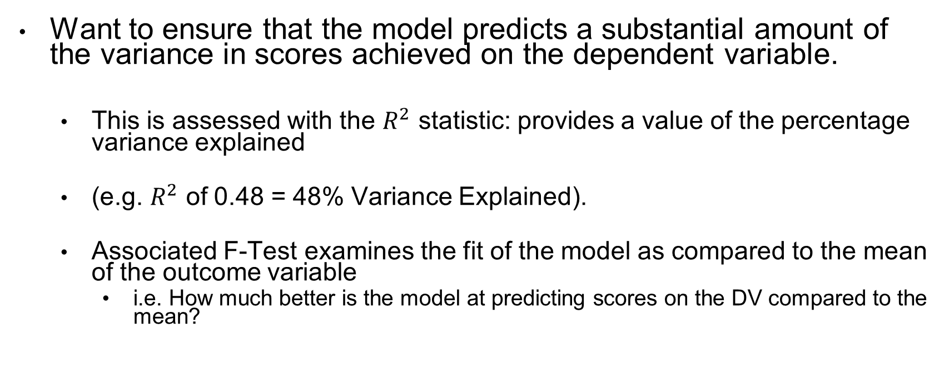
Evaluating Standard Multiple Regression
Want to ensure that the model predicts a substantial amount of the variance in scores achieved on the dependent variable.
This is assessed with the $R^{2}$ statistic: provides a value of the percentage variance explained
(e.g. $R^{2}$ of 0.48 = 48% Variance Explained).
Associated F-Test examines the fit of the model as compared to the mean of the outcome variable
i.e. How much better is the model at predicting scores on the DV compared to the mean?

Slide 18
Testing Multiple Parameters
As with linear regression, we hope that each parameter contributes substantially to explaining the model
To test the value of each parameter in our model, we perform a t-test on each parameter.
Effectively, we are still estimating each slope (or the point of intersection) in comparison to 0.
If a predictor does not contribute to our model, we can consider dropping it.

Slide 19
In a Multiple Regression you are trying to find out…
1. Is my regression model better than the mean for predicting outcomes?
2. How much of the variance in the Outcome is explained by the Predictors?
3. Is the Predictor (IV) significantly related to the Outcome (DV?)
4. What is the size and direction of the relationship between the Predictor and Outcome?

Slide 20
LECTURE OUTLINE
Recap: Linear Regression
What is Multiple Regression (MR)?
Standard Multiple Regression
Evaluating standard regression model
Sample size & Effect Size
Types

Slide 21

“Don’t use multiple regression as a fishing expedition”
Regression models must be theoretically driven
(Pallant, 2020)

Slide 22
Multiple Regression Models
Although the model is more complicated, the basic principle is the same.
Aim is to find the linear combination of predictors that correlate maximally with the outcome variable.
We can add as many predictors as we want
General rule: The fewer predictors the better!
The predictors included and the way in which they are entered into the model have a great impact => should be
Based on previous research and theoretical importance
Don’t just enter loads and hope for the best
If variables are completely uncorrelated the order of entry has little impact on the parameters calculated BUT we rarely have uncorrelated predictors in psychology.
Notes:
Covariability of X and Y / separately

Slide 23
Multiple Regression – why are fewer predictors better? (1)
1. Improved Interpretability & Parsimony
A simpler model with fewer predictors is easier to interpret (its clearer which variables are truly important).
In line with Occam’s Razor (a philosophical problem solving principle), a model should be as simple as possible while still explaining the data effectively (i.e., parsimonious).
Fewer predictors allows for balance between accuracy and simplicity).

Slide 24
Multiple Regression – why are fewer predictors better? (2)
2. Reduces erroneous inferences related to overfitting and multicollinearity
Too many predictors can lead to overfitting (i.e., the model captures noise rather than true patterns)
Including too many predictors increases the risk of multicollinearity (i.e., predictors are highly correlated with each other, so it is difficult to determine their individual contributions)

Slide 25
Multiple Regression – why are fewer predictors better? (3)
3. Improves statistical power to have fewer predictors
More predictors require a larger sample size to detect significant effects.
With fewer predictors, statistical power is better and risk of Type II errors is less

Slide 26
A note on Sample Size for Multiple Regression
Ratio of Cases to IVs should be substantial
Should be more than 100 participants, or that there should be (ideally) at least 20 participants per IV.
Stevens (1996):about 15 subjects per predictor
Size matters: The more people in your sample the better the chance of the results being replicated.
Green (1991) proposed a method for determining a minimum sample size to test the R² of a regression model.
minimum sample should be greater than 50 + 8k, where k is equal to the number of independent variables.
Notes:
Covariability of X and Y / separately

Slide 27
A note on Sample Size for Multiple Regression
However a higher ratio is needed when
DV is skewed
Poor reliability in measures, leads to substantial measurement error and reduces the true relationships
Stepwise methods (45-50 subjects / variable)
the larger the sample (N) is, the larger the denominator will be and therefore the standard error will be smaller. These smaller standard errors mean that your parameter estimates are more accurate.
Notes:
Covariability of X and Y / separately

Slide 28
Multiple regression: Effect Size
If we measured the entire population from which we have randomly selected our sample, the size of the correlation or regression coefficient we would find is known as the effect size.
multiple regression, the effect size is equal to R².
The larger the effect size, the greater the chance we have of finding it.
Cohen (1988) has defined small, medium and large effect sizes for values of R2.
He defined a small value as R² = 0.02,
a medium size as R² = 0.13
and a large size as R² = 0.26.

Slide 29
Types of Multiple Regression Models
Hierarchical Linear regression
based on past work
experimenter decides order
enter known first and in order of importance in predicting the outcome, then add any new ones either all in one go (stepwise) or also in hierarchical fashion.
Standard / Simultaneous/ Forced Entry / Direct
All parameters are forced in together
Relies on good theoretical reasons but no decision is made on order entry (useful for theory testing)
More on this next week
Notes:
Look at Forced Entry (standard MR) this week; Hierarchical Regression next week.

Slide 30
LECTURE OUTLINE
Recap: Linear Regression
What is Multiple Regression (MR)?
Standard Multiple Regression
Evaluating standard regression model
Sample size & Effect Size
Assumptions

Slide 31
Assumptions of Multiple Regression
2. Normality of residuals
3. Independence of observations (or independence of errors)
4. Homoscedasticity
6. No outliers, influential points
5. Linear relationship between each IV and DV
1. Little/No Multicollinearity
Assumption
Check
Assumption met if
Cooks distance, leverage & visual inspection of scatterplot
Normal Probability Plot (P-P) of Regression Standardised Residual
Scatterplots (regression output)
Scatterplots (regression output)
Correlations/
Tolerance/VIF
Durbin Watson statistic
Cook’s distance
Cooks value should be less than 1 (otherwise indicates influential point). No values distorting line disproportionately
VIF less than 10
Tolerance greater than .10
Correlation less than .7
Bell curve to histogram or pp plot approximately follows the line
Should be equal to 2
Should look like a cloud rather than a funnel
Evenly scattered – not curved

Slide 32
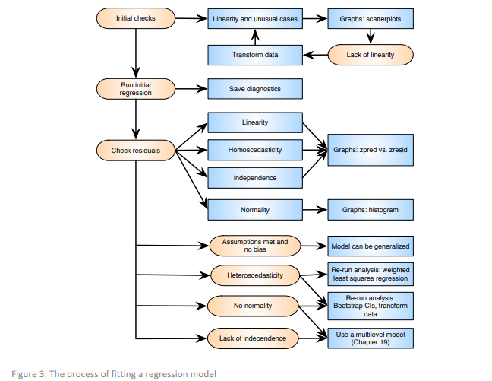
Stepwise process for running Multiple Regression

Slide 33
Testing Assumptions of Multiple Regression 1. Multicollinearity
Multicollinearity occurs when 2+ Ivs are highly correlated with one another ( r > .80 is too high)
Both IVs measure the same construct.
Determining the importance of a given predictor difficult - effects of predictors are confounded
Multicollinearity is problematic because redundant/extra variables can inflate amount of error and shared variance between variables
Multicollinearity is present if…
Tolerance >0.1
VIF <10
Correlation >.7
Notes:
Covariability of X and Y / separately
High Correlations are more of a problem in Regression than they are in MANOVAs
two or more independent variables that are highly correlated with each other. This leads to problems with understanding which independent variable contributes to the variance explained in the dependent variable, as well as technical issues in calculating a multiple regression model.

Slide 34
Testing Assumptions of Multiple Regression 2. Independence of residuals
The degree of error per case should be uncorrelated with the degree of error from another case.
Durbin-Watson statistic
Is the Durbin Watson value 0-1 or 3-4?
If so assumption is violated
We want a value between 2-3 to meet assumption

Slide 35
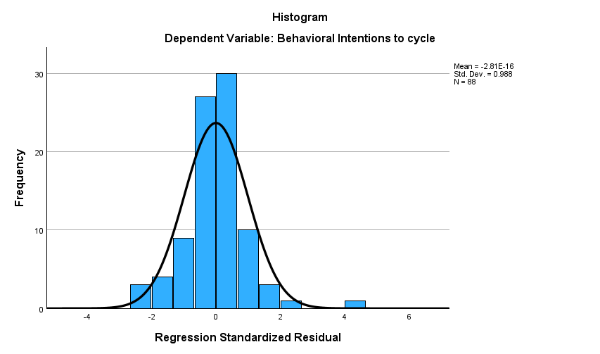
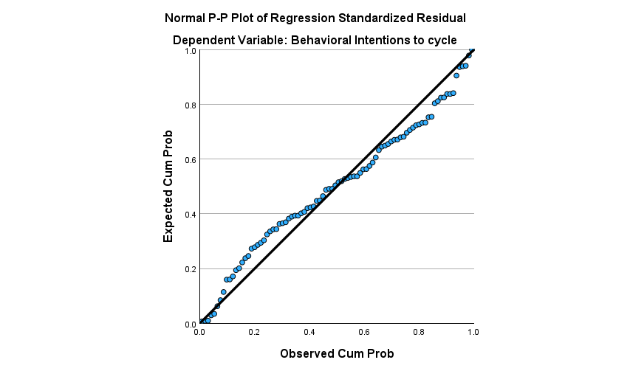
Testing Assumptions of Multiple Regression 3. Normality of Residuals
Normal Probability Plot (P-P) of Regression Standardised Residual gives information about normality of residuals. We want variables to be present in a reasonably straight line
Histogram – bell curve shape

Slide 36
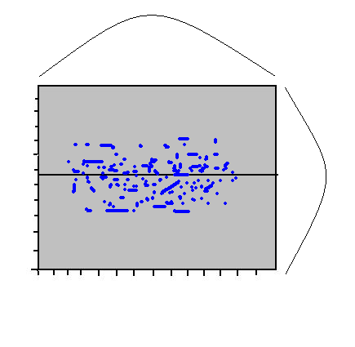
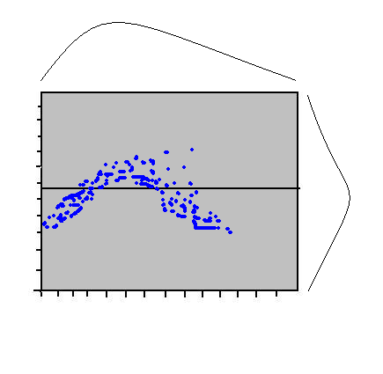
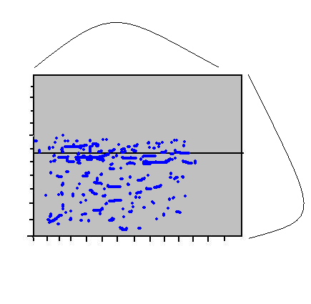
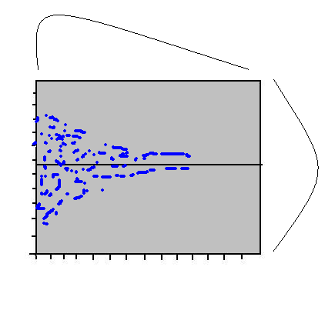
Checking for Assumptions 4. Linearity between IV and DV after controlling for other predictors
Scatterplot also indicates linearity, normality & heteroscedasticity.
Should have reasonable scatter/spread throughout: a central rectangular shape indicates normality
A curvilinear shape indicates non-linearity.
A rectangle that is considerably off-centre indicates a skew.
Notes:
Scatterplot relates to residuals – we want this to be heteroscedastic
As we saw last week, we can also observe other problems with our data from the scatterplot – what was this last week? Outliers

Slide 37
Testing Assumptions of Multiple Regression 5. Homoscedasticity
Scatterplot also indicates linearity, normality & heteroscedasticity.
Should have reasonable scatter/spread throughout: a central rectangular shape indicates normality
A curvilinear shape indicates non-linearity.
A rectangle that is considerably off-centre indicates a skew.
More weight on one side suggests some degree of heteroscedasticity.

Slide 38
Testing Assumptions of Multiple Regression 5. Homoscedasticity
Homoscedasticity means the variance of the residuals (errors) remains constant across all levels of the independent variable(s).
It ensures that the regression model is reliable across all values of the predictors.
Is is indicated when the residuals (errors) are evenly spread across all predicted values (e.g., a scatterplot of residuals vs. fitted values shows a random cloud of points).
If there is no even spread – this assumption is violated

Slide 39
Testing Assumptions of Multiple Regression 6. No extreme values/outliers/influential points
Need to ensure extreme values are not having too much effect on our model.
1. Scatterplot gives indication of outliers that may be influencing model shape.
2. Multivariate Outliers are checked by examining Mahalanobis Distance value in Residual Statistics Table.
Check the Maximum value against a critical value for Mahalanobis Distance table (varies by number of independent variables).
Mahalanobis Distance values above the critical values, indicate the presence of multivariate outliers.
3. Influential Cases are checked in the Residuals Statistics Table with the Cook’s Distance value
Check the Maximum value to ensure it is not >1 on this statistic {as per Tabachnick & Fidell (2011)}.
If the value <1, outliers or individual cases are not influencing the model too much.

Slide 40
Recommended Reading
Tabachnick & Fidell Chapter 5
Dancey, C.P. & Reidy, J. (2011). Statistics without mathematics for psychology, 5th edition, Chapter 12. London: Prentice-Hall.
Field, A. (2009). Interpreting statistics with SPSS, 3rd Edition, Chapter 7. London: Sage Publications.
Chapter 13 of Pallant, J. (2005) SPSS survival manual. Maidenhead, Berks.: OUP. 2nd edition.
Miles, J & Shevlin, M. (2001) Applying Regression and Correlation; a Guide for Students and Researchers. London: Sage.

Slide 41
Thanks

