Slide 1
PSY1055 Advanced Psychology Research Skills
CONTINUOUS ASSESSMENT 3 (CA 3)
REPORT
OVERVIEW OF ASSIGNMENT

Slide 2
Continuous Assessment 3
Implicit Attitudes to Race (Social Cognitive Psychology) Report
Due Friday 27th February, 5pm
18.75% of final mark
2,500 words (excluding abstract, footnotes, appendices and references).
You must insert a word count.
Students who greatly exceed this limit (by more than 250 words) will not be given credit for the excess words, and will be penalised by losing 10% off the total mark.
Submission via Loop CA3 portal

Slide 3
Overview of CA3
Implicit Attitudes to Race (Social Cognitive Psychology) Report
A detailed handbook on the report is available on Loop – read through these guidelines carefully.
You are required to conduct a brief literature review, develop a research question, analyse the data using basic descriptive analyses and standard multiple regression analyses and interpret your findings.
This project will assess your ability to appropriately analyse raw quantitative data to (a) test multivariate assumptions and (b) carry out a standard multiple regression, and your ability to interpret and write up a quantitative report.

Slide 4
Overview of CA3
Implicit Attitudes to Race (Social Cognitive Psychology) Report
You will not be required to collect data for this assignment, data will be provided to you.
For learning purposes and to gain insight into how the implicit bias tests work, you can choose to complete the standard Race IAT at the Project Implicit (PI) IAT demonstration website. Go to the Project Implicit web page: https://implicit.harvard.edu.
You can follow the on-screen instructions to complete the test.

Slide 5
Continuous Assessment 3
Implicit Attitudes to Race (Social Cognitive Psychology) Report
An introduction to this research topic is provided in the Background section below.
You are required to
Literature review: conduct a brief literature review that extends beyond the key readings given in the background section [literature examining development & use of IAT AND prejudice & racism should be included]
Research Hypotheses: develop a research question and research hypotheses and state at end of the Introduction
3. Study Methodology and Sample: describe design, participants, methods, procedure.
4. Identify and conduct appropriate analysis using PSY1055_Report3_RACE_Data.sav
  Descriptive statistics
  Inferential statistics (Multiple regression) (report on assumptions & report according to APA)
5. Discussion & Interpretation: interpret main findings in relation to literature provided in the Introduction and discuss study strengths/limitations and directions for future research
6. References

Slide 6
Continuous Assessment 3
*Indication of breakdown of word count – this is not prescriptive
Abstract 150 words
Introduction 800 words
Method 400 words
Results 350 words
Discussion 800 words
Appendices No word limit

Slide 7
CA3 Marking Rubric
 | Section | Demonstrate | %
1 | Title and abstract | Informative title and succinct but comprehensive summary of sections 2-5 of the report. | 10
2 | Introduction | Knowledge and understanding Breadth and depth of reading | 20
3 | Methods | Participants, design, materials, procedure (summarised from Report 4 guidelines and data) | 20
4 | Results | Demonstrate the ability to conduct and report (APA style) the appropriate descriptive and inferential analysis following the direction given in the Report 4 guidelines and practical class. | 20
5 | Discussion | Knowledge and understanding | 20
 |  | Critical evaluation
6 | Presentation | Presentation, referencing, overall structure. Adherence to APA style. | 10

Slide 8
CA3 Marking Rubric
Grade Band | Mark Range | Descriptor
First Class Honours | 70–100% | Excellent understanding, critical analysis, and academic writing throughout. Correct, accurate conducting and reporting of statistics in line with APA formatting.
Upper Second Class (2.1) | 60–69% | Very good engagement with material and clear communication, though minor areas for development. Mostly correct and accurate conducting and reporting of statistics, although some minor errors or deviations from APA formatting.
Lower Second Class (2.2) | 50–59% | Satisfactory understanding with some critical insight, but analysis and clarity could be improved. Statistical analyses are conducted and reported satisfactorily, though with some inaccuracies or omissions that limit clarity and precision.
Third / Pass | 40–49% | Basic grasp of topic but lacking depth, criticality, or clarity in places. Statistical analyses are conducted and reported at a basic level, with limited accuracy or clarity, but sufficient to demonstrate minimal understanding.
Fail | <40% | Insufficient understanding or structure. Serious issues in content, analysis, or presentation. Statistical analyses are absent or fundamentally flawed, with reporting that is incoherent or insufficient to demonstrate understanding.

Slide 9
Criteria | First (70%+) Excellent | 2.1 (60–69%) Very Good | 2.2 (50–59%) Satisfactory | Pass (40–49%) | Fail (<40%)
Title & Abstract (/10) | Title is clear, informative, and succinct. Abstract concisely summarises topic, rationale aims, design, sample, analysis, findings, and implications. | Title is appropriate and mostly concise. Abstract includes key elements, but may lack detail or clarity in one area. | Title and abstract present the main ideas but are either overly general or missing detail. | Vague or incomplete. Some key elements missing, but basic purpose is apparent. | Very vague or absent. Key elements missing. Little or no understanding demonstrated.
Introduction (/20) | Strong depth of knowledge and critical engagement. Key concepts defined; literature reviewed critically. Highly coherent and logically sequenced structure with smooth and effective transitions between points. Research gap and rationale coherently communicated and well-reasoned. Brief overview of methods provided; Hypotheses and research questions clear and specific. | Generally strong engagement with literature and very good understanding, though critical depth or structural clarity may be inconsistent. The research gap, study rationale, hypotheses and research questions are communicated, but lack specificity and/or depth. | Basic elements covered. Limited critical engagement. Uneven structure. Hypotheses and research questions are poorly articulated and difficult to identify. | Minimal engagement with literature. Largely descriptive with weak structure. Research questions or hypotheses are unclear or omitted. | Superficial or incoherent discussion. Major omissions. Unclear structure and purpose.
Methods (/20) | All subsections detailed: 1. Design (IVs & DVs clearly identified), 2. Participants (recruitment, inclusion criteria, demographics - full sample described in terms of gender (ratio), age (M, SD),), 3. Materials (validity/reliability, scoring procedures for all variables). 4. Procedure and 5. Data analysis accurately and succinctly described | All key subsections present with minor omissions or lack of detail or clarity. | Most subsections present but superficial. Limited attention to design, participants, or materials. | Key subsections present but poorly described. Important details unclear or missing. | Several key sections missing or inaccurate. Method cannot be understood or evaluated.
Results (/20) | Full descriptive statistics reported accurately including RACE IAT Scores (M, SDs), racial preference scores (M, SD) and political ideation scores (M, SD). Statistical assumptions checked. Regression clearly reported and interpreted in accordance with APA formatting. Inclusion and correct interpretation of graphs/figures as appropriate. | Most descriptives included. Regression mostly accurate and reported in APA style. Assumptions mentioned. | Basic descriptives provided. Regression reporting may contain errors or lack clarity. | Incomplete descriptives. Errors in analysis or reporting limit interpretation. | Results largely missing, inaccurate, or poorly organised.
Discussion (/20) | Findings clearly summarised and interpreted with strong links to literature. Insightful critique, limitations, implications, and well-considered future directions. | Findings well interpreted with some critical insight. Strengths and limitations acknowledged, though discussion may be general. | Findings described with limited interpretation. Weak critical engagement with literature. | Minimal interpretation. Limited or unclear links to literature and implications. | Very limited or absent discussion. No meaningful interpretation or literature integration.
Presentation & APA (/10) | Well-structured and polished. Consistent APA referencing. Few or no errors. | Clear structure. Minor formatting or APA errors. | Adequate structure. Some APA, grammar, or formatting errors. | Weak structure. Frequent APA and grammatical errors that reduce clarity. | Poor structure and extensive APA and language errors that impede understanding.

Slide 10
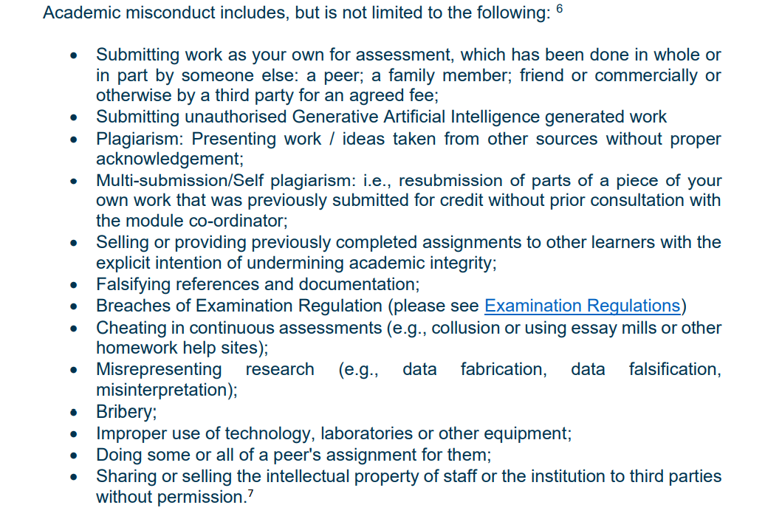
DCU Academic Integrity Policy
https://www.dcu.ie/system/files/finance_editor/2023-09/1%20-%20academic_integrity_policy_v5.0_final.pdf

Slide 11
Continuous Assessment 3
Academic misconduct includes:
Plagiarism (any published works) will lead to an automatic fail and/or other penalties as outlined in the DCU student handbook.
Submitting unauthorised Generative Artificial Intelligence generated work
Students should refer to APA guidelines on writing reports in Psychology.

Slide 12
Thanks

