Slide 1
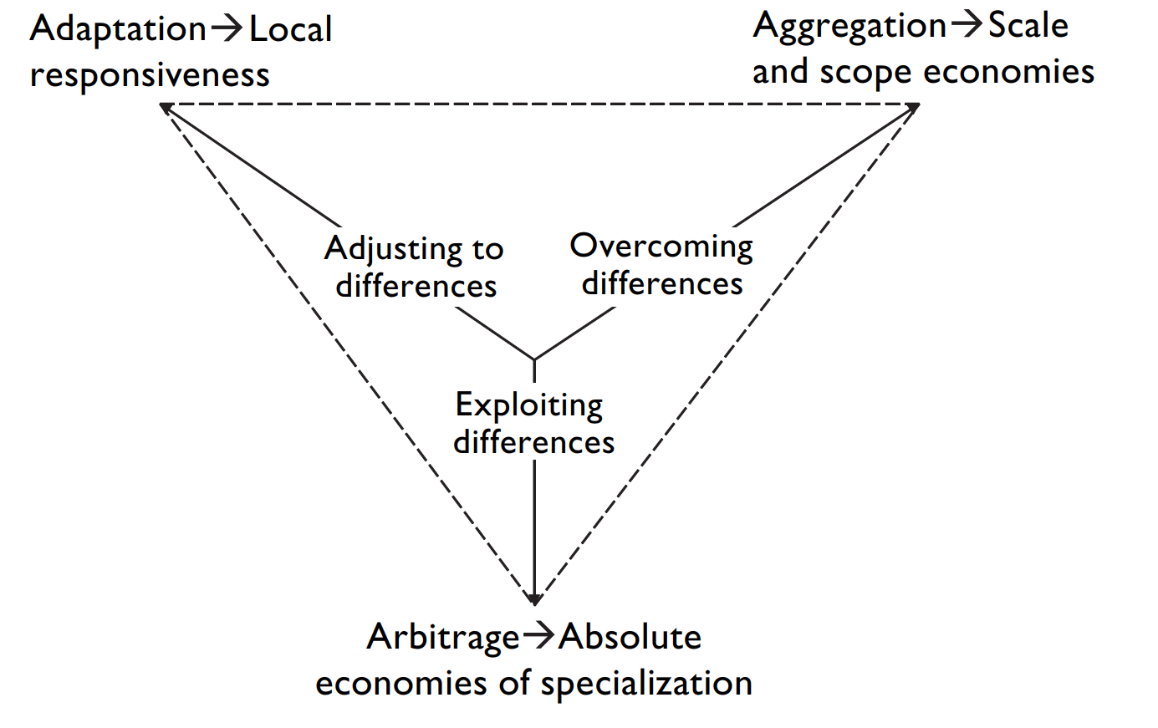
The AAA Framework
(Ghemawat, 2008, p. 200)

Slide 2
The AAA Framework
Seeking to increase revenues and market share by tailoring products/services/business model to suit local requirements
Seeking economies of scale through, for example, centralising development and production processes to attain global efficiencies and competitive advantage
Product Adaptation is critical and somewhat unavoidable. Hence the most used global strategy, probably?
Seeking to leverage economic or other differences between national or regional markets by , for example, locating separate parts of the supply chain in different places, location of headquarters for taxes purposes, etc.
(Ghemawat, 2008; Open University of Hong Kong, 2015)

