Slide 1
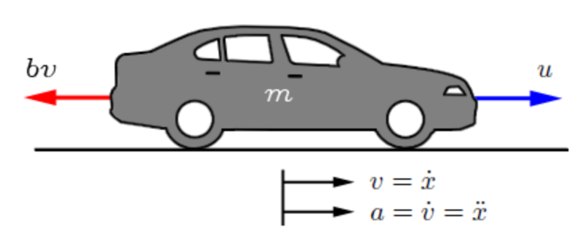

CSAD 402 Assignment 4 Design the Physical Implementation of a Car Cruise Control System.
High-level design for the physical
implementation of the control system.
Brian Butler (S00220518)
Notes:
Hi, this is Brian Butler and here is my assignment presentation to design the physical implementation of a Car Cruise Control System.

Slide 2

Introduction:
The objective of this assignment is to carry out a high-level design for the physical implementation of the control system of a cars cruise control system.
Cruise control is an electronic system that allows the driver of a car to set the cars velocity to a particular value and the car should maintain this velocity without the need for the drivers' foot to intervene with the accelerator pedal.
The following specification for the control system is required:
Zero steady-state error in response to a unit step reference signal
2% Settling time of 3s & 5% Overshoot.
Notes:
This is a high level design following the specifications outlined.

Slide 3
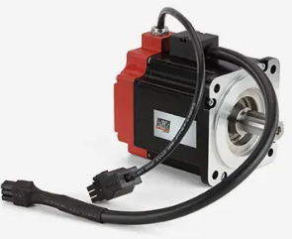
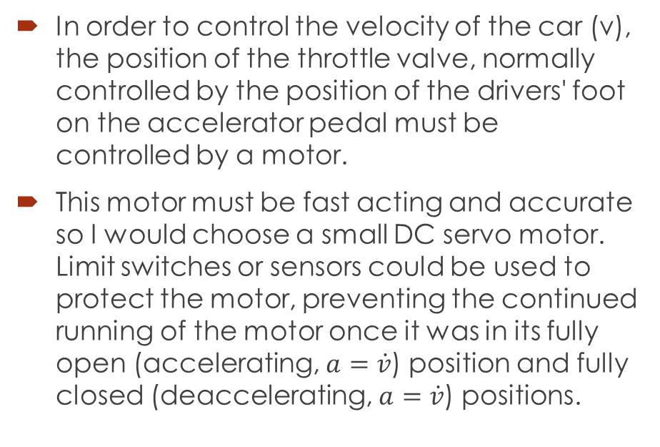
Motor and Sensor Selection:
In order to control the velocity of the car (v), the position of the throttle valve, normally controlled by the position of the drivers' foot on the accelerator pedal must be controlled by a motor.
This motor must be fast acting and accurate so I would choose a small DC servo motor. Limit switches or sensors could be used to protect the motor, preventing the continued running of the motor once it was in its fully open (accelerating, $a=\dot{v}$) position and fully closed (deaccelerating, $a=\dot{v}$) positions.
Notes:
In order to control the velocity of the car (v), the position of the throttle valve, normally controlled by the position of the drivers' foot on the accelerator pedal must be controlled by a motor.
This motor must be fast acting and accurate so I would choose a small DC servo motor.
Limit switches or sensors could be used to protect the motor.

Slide 4
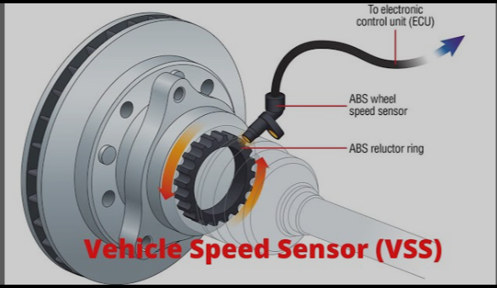
Sensor Selection:
To measure the velocity of the car an electronic speed sensor (VSS) is fitted to the transmission or ABS system. This would be a magnetic sensor that acts like an encoder, counting the revolutions of the shaft. This angular velocity is fed back to an ECU (Engine Control Unit) which takes into account factors like wheel diameter and calculates the velocity of the vehicle.
The system is observable and an observer rather than a sensor can be used to calculate acceleration, the rate of change of the measured velocity.
Notes:
To measure the velocity of the car an electronic speed sensor (VSS) is fitted to the transmission or ABS system. The angular velocity measured, is fed back to an ECU (Engine Control Unit) which takes into account calibration factors like wheel diameter and calculates the velocity of the vehicle.
An observer rather than a sensor can be used to calculate acceleration, the rate of change of the measured velocity.

Slide 5
Sensor Selection Continued:
Throttle position would be fed back to the ECU from the servo motor.
Sensors or switches on the brake, accelerator and clutch pedals would also be required in order to disengage the cruise control system if there was any interaction with these pedals.
This is a vital feature of any cruise control system for safety reasons.
Notes:
Throttle position would be sent back to the ECU while Sensors or switches on the brake, accelerator and clutch pedals would also be required in order to disengage the cruise control system if there was any interaction with these pedals.
This is a vital feature of any cruise control system for safety reasons.

Slide 6
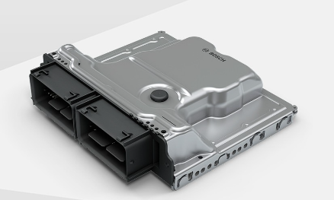
Hardware and Software:
Using a PLC (Programable Logic Controller) with ladder logic software would not be suitable for controlling this system as it would be larger and more cumbersome than is necessary.
Instead, a micro controller, capable of PID (Proportional, Integral, Derivative) Control, called an ECU, would be used because they are small, flexible, fast acting, inexpensive and easy to use.
Notes:
A micro controller, capable of PID Control, called an ECU (Engine Control Unit), would be used because they are small, flexible, fast acting, inexpensive and easy to use.

Slide 7
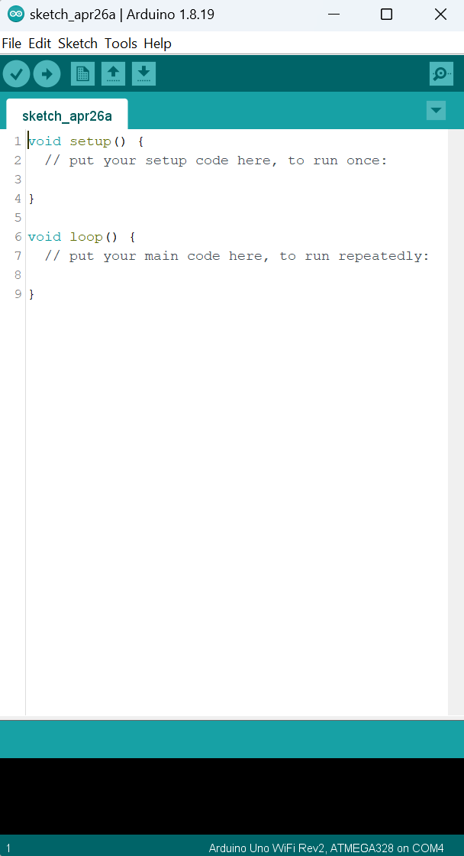
Hardware and Software Continued:
Although not suitable here, an example of a range of micro controllers is the Arduino micro controllers (designed for educational purposes).
The Arduino has its own software environment, the IDE (Integrated Development Environment) and the ECU would have something similar, programmed in C or C++, similar to the Arduino.
Notes:
Although not suitable here, an example of a range of micro controllers is the Arduino micro controllers (designed for educational purposes). The Arduino has its own software environment, the IDE (Integrated Development Environment) and the ECU would have something similar, programmed in C or C++, similar to the Arduino.

Slide 8
PID Control:
With PID (Proportional, Integral, Derivative) Control. The throttle control valve is moved proportionately to the error in velocity that is fed back from the VSS. The integral control compares the distance travelled with the desired distance over a nominated period of time, with distance being the integral of velocity. This works towards eliminating any steady state error in the system. In order to improve how reactive the system is, derivative control is used. Acceleration is the derivative of velocity and adjusting the throttle based on error in acceleration improves the response time of the system.
Added together, the proportional, integral and derivative factors are all used to calculate where the throttle valve should be at any given time.
Notes:
With PID (Proportional, Integral, Derivative) Control. The throttle control valve is moved proportionately to the error in velocity that is fed back from the VSS. The integral control compares the distance travelled with a desired distance over a nominated period of time, with distance being the integral of velocity. This works towards eliminating any steady state error in the system. In order to improve how reactive the system is, derivative control is used. Acceleration is the derivative of velocity and adjusting the throttle based on error in acceleration improves the response time of the system. Added together, the proportional, integral and derivative factors are all used to calculate where the throttle valve should be at any given time.

Slide 9
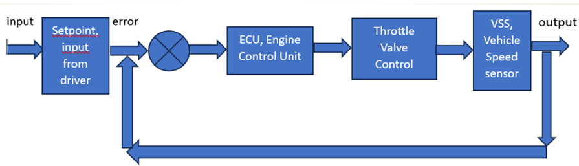
Controller Interface:
The driver choses the setpoint on an onboard HMI, and enters it into the system. The ECU interprets this input and feeds it to the throttle control valve, opening the valve to increase velocity or closing to decrease. The VSS reads the actual velocity of the vehicle and sends an error signal back to the ECU where the process starts again and the vehicles velocity is maintained regardless of outside factors like road gradient or wind,
Notes:
The Controller Interface – below is a flow chart illustrating how The driver choses the setpoint on an onboard HMI, and enters it into the system. The ECU interprets this input (along with distance and acceleration data) and feeds it to the throttle control valve, opening or closing as appropriate. The VSS reads the actual velocity of the vehicle and sends an error signal back to the ECU where the process starts again and the vehicles velocity is maintained regardless of outside factors like road gradient or wind,

Slide 10
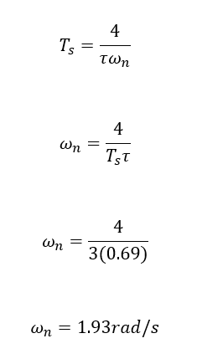
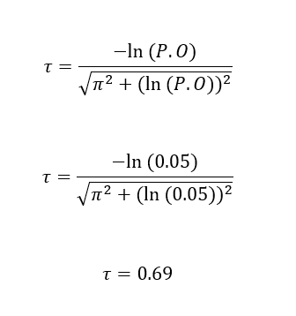
Control Algorithm:
Using the specifications for the controller, outlined in the assignment we can calculate the desired characteristic equation.
Notes:
Using the specifications for the controller, outlined in the assignment we can calculate the desired characteristic equation. First calculating the damping ratio and natural frequency.

Slide 11
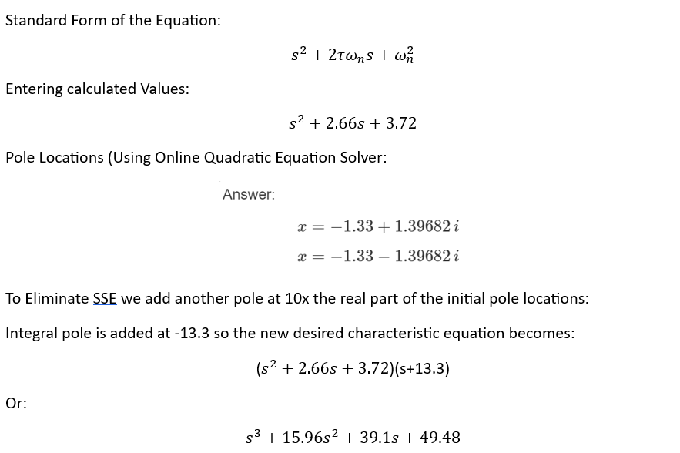
Control Algorithm Continued:
Notes:
And then the characteristic equation including an added pole to eliminate SSE

Slide 12
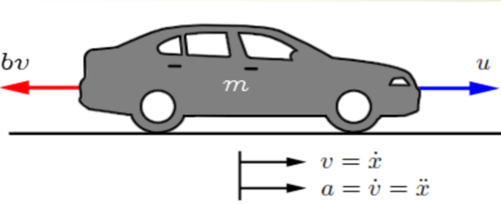
Conclusion:
Using the motor, sensors, hardware, and software outlined should enable the system to behave within the specifications outlined in the assignment.
Using MatLab or Simulink to test the system response is advised.
Notes:
In conclusion, Using the motor, sensors, hardware, and software outlined should enable the system to behave within the specifications outlined in the assignment and Using MatLab or Simulink to test the system response is advised.

